Slide 1
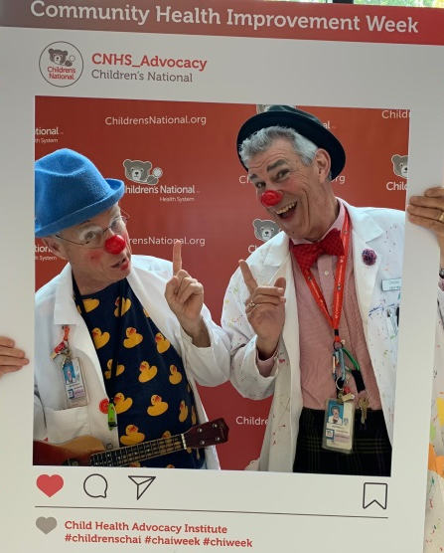
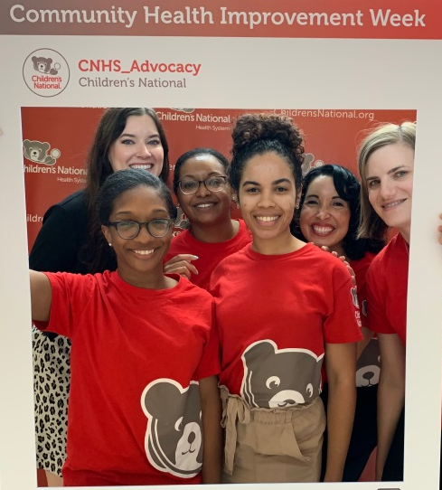
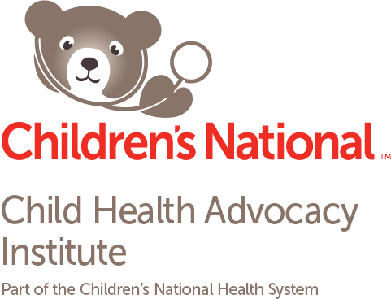
80%
Percentage of health that health behaviors, socioeconomic factors and the physical environment account for.
Source: County Health Rankings and Roadmaps
Community Health Improvement Week 2019
at Children’s National
Grand Rounds focused on collaborative models to advance mental health in schools
200 sandwiches delivered to Martha’s Table
9 community-based partners led activities throughout the week
32 Clinical and Translational Science Institute and Children’s National leaders educated about the social determinants of health
The Child Health Advocacy Institute (CHAI) at Children’s National celebrates community health improvement to raise awareness, demonstrate impact and increase the understanding of the vital role of community health improvement strategies to advance the health and well-being of our communities.

Slide 2
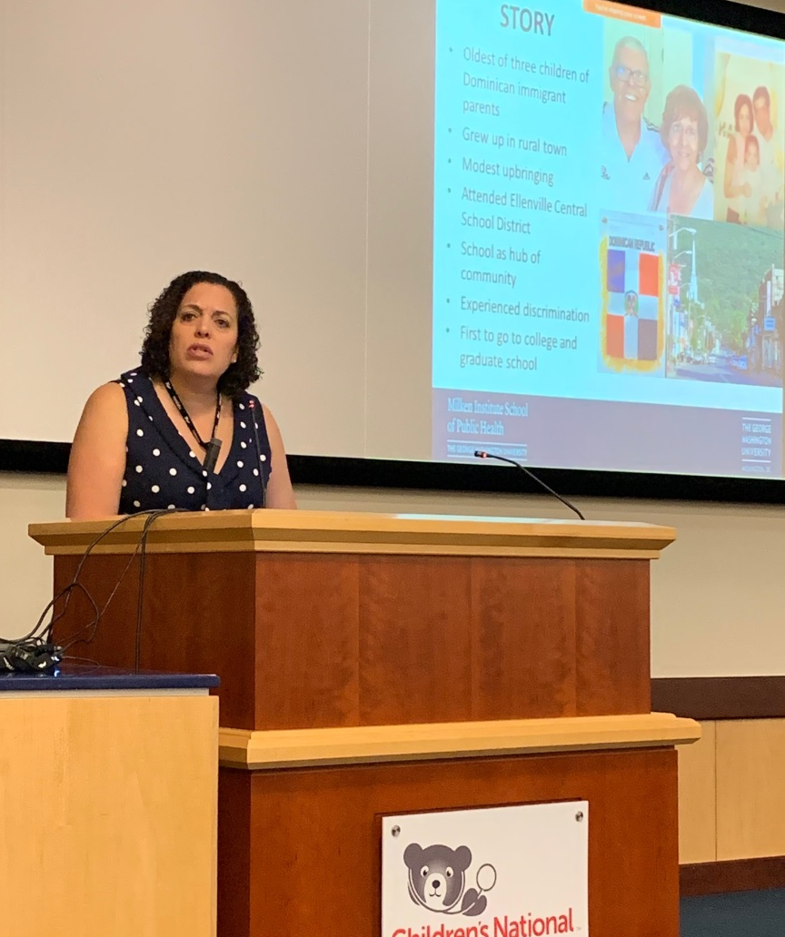
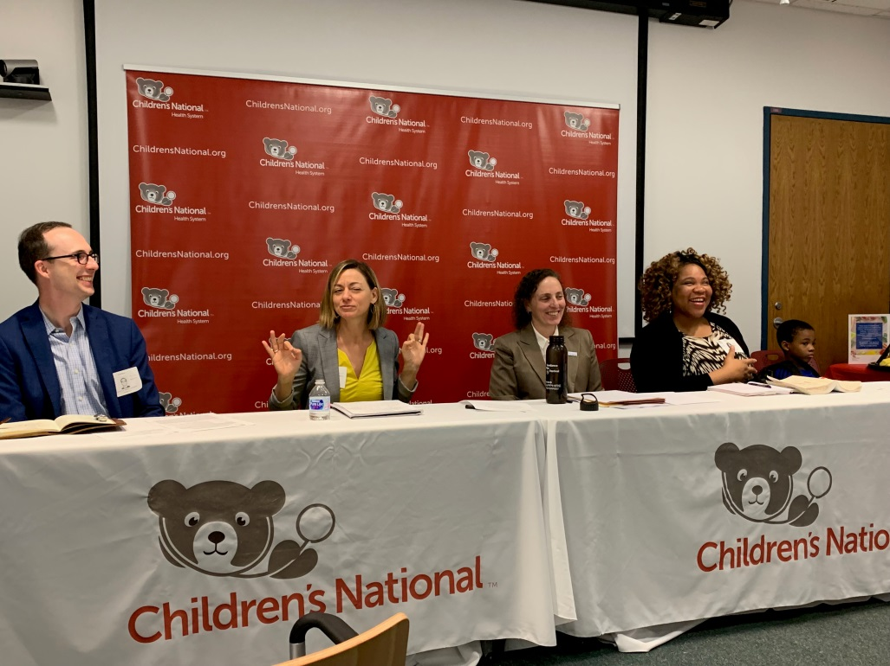
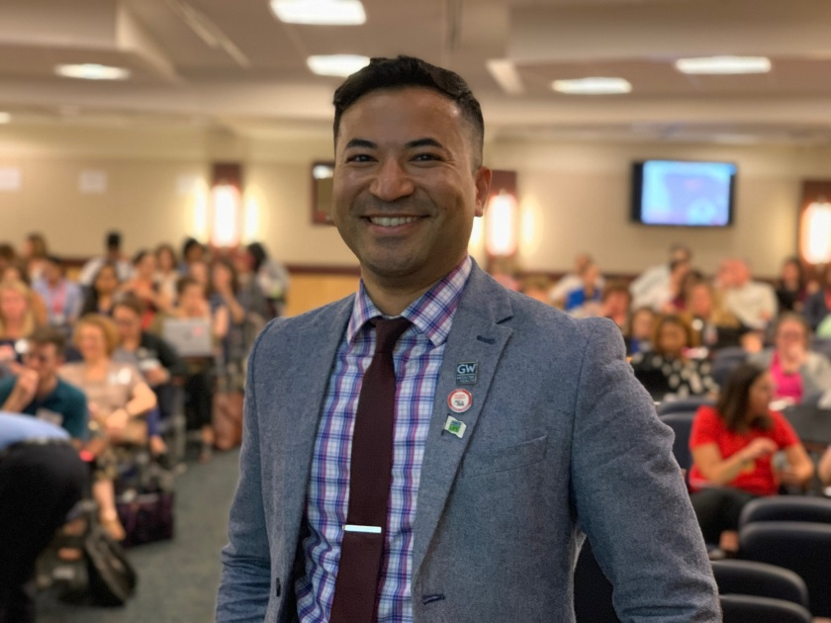
Education
Lectures and roundtables throughout the week focused on mental health and wellness and community partnerships.

Slide 3
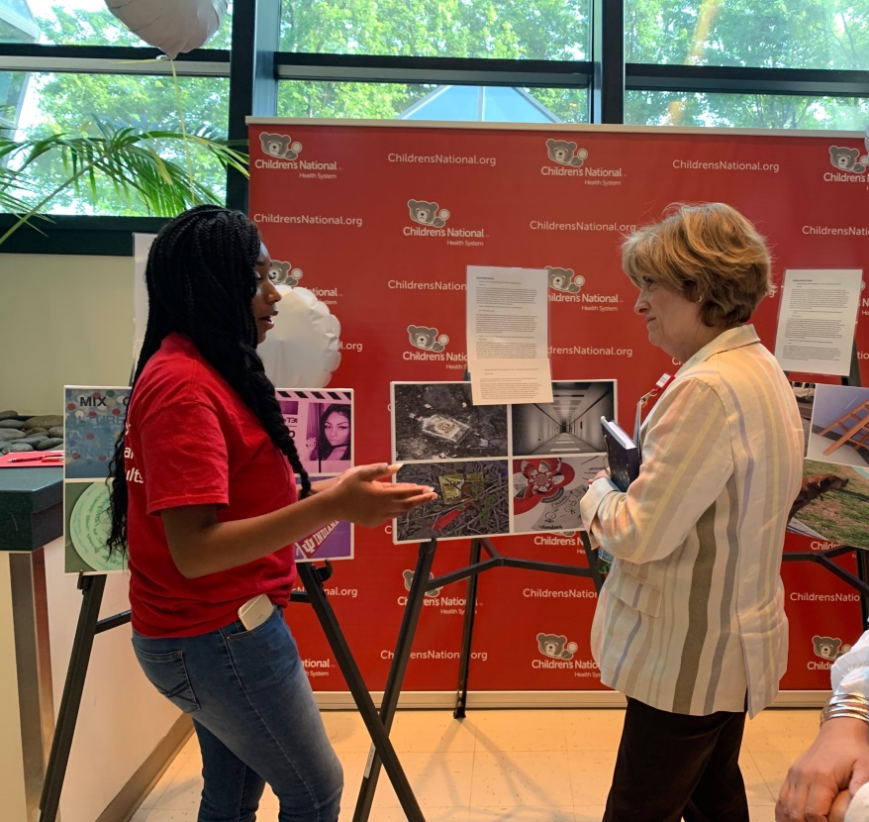
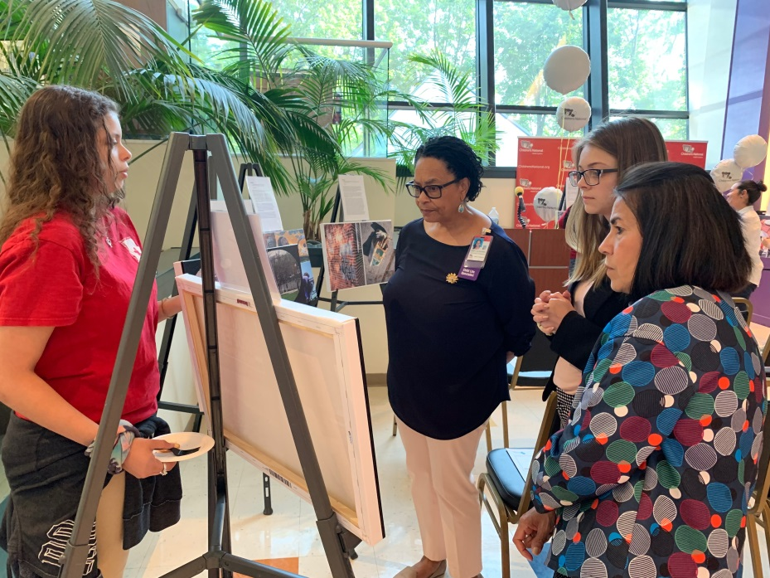
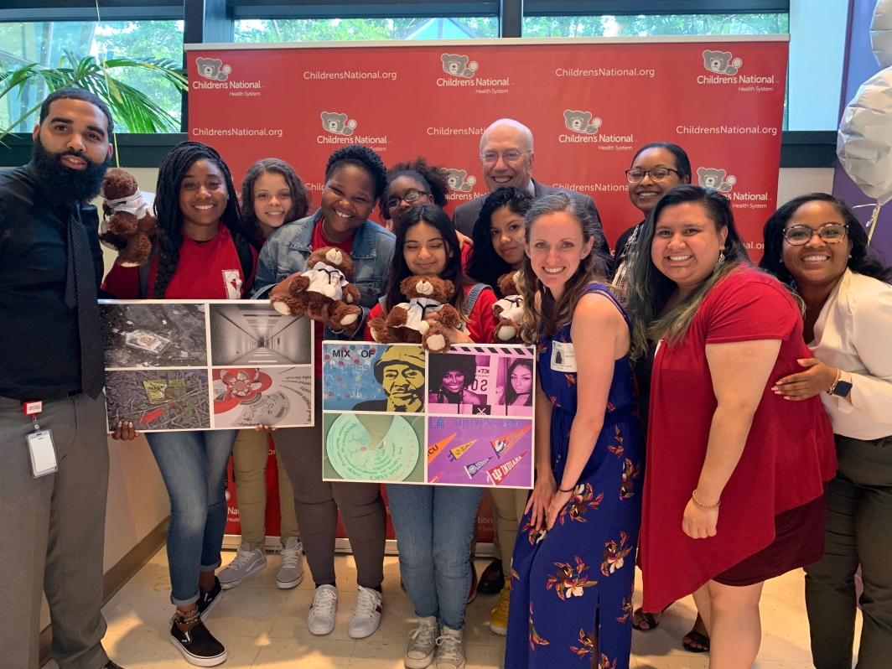
PhotoVoice
Exhibit
Youth from the Latin American Youth Center expressed their voices and raised awareness about mental health and wellness through photography.

Slide 4
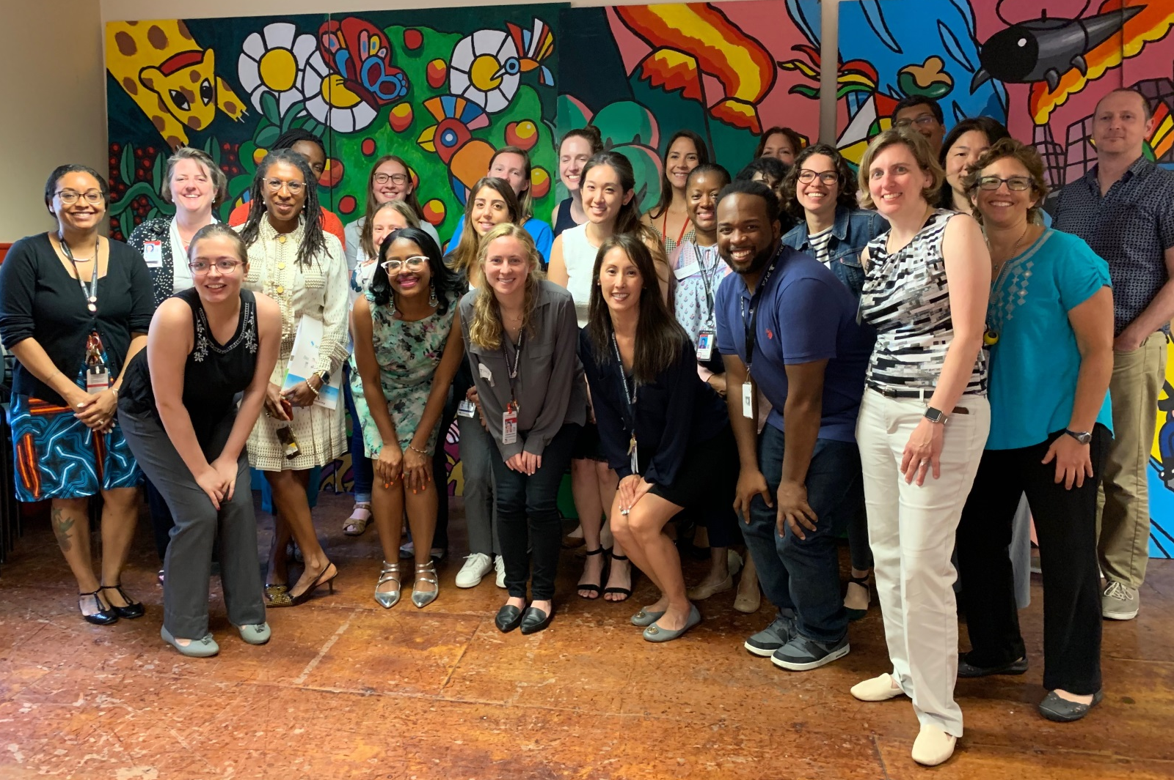
A Moving Conversation
Clinical and Translational Science Institute and Children’s National leaders visited local neighborhoods on a guided bus trip and site visit to learn first-hand about community characteristics, health needs, barriers, and assets in Washington, DC.

Slide 5
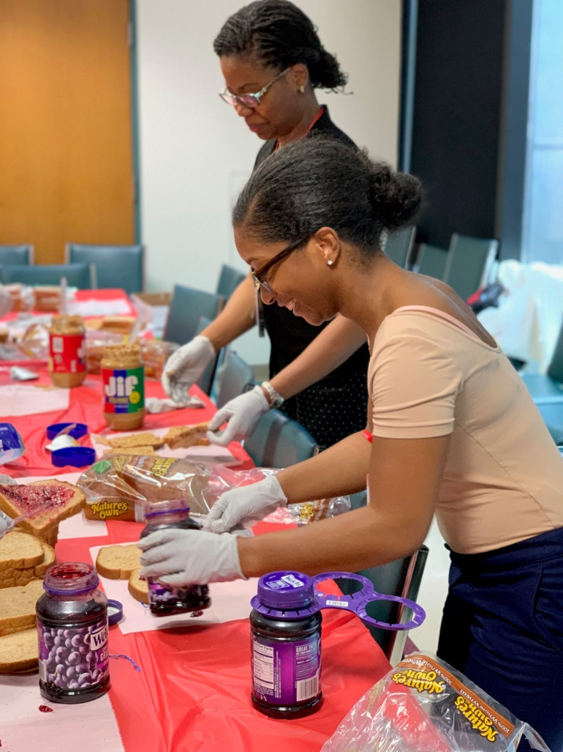
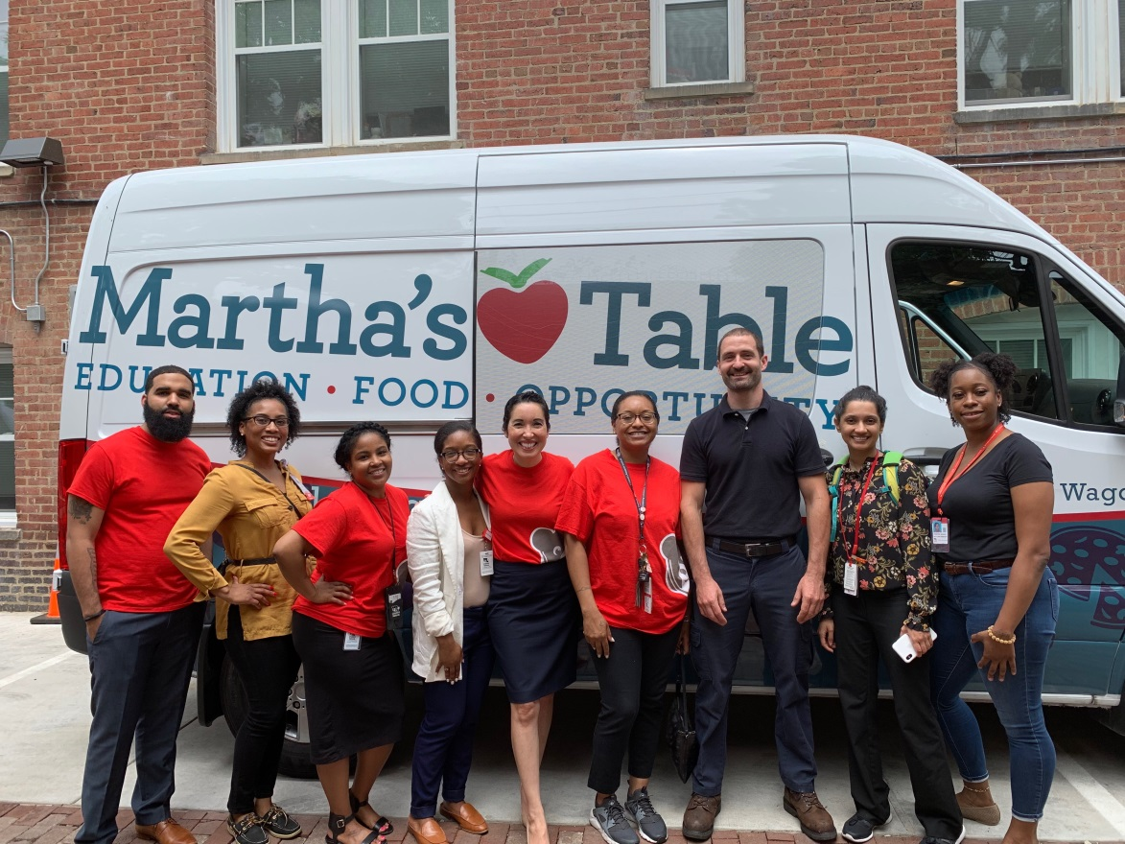
Community Service
Staff participated in a community service project preparing 200 sandwiches for Martha’s Table children and families.

