Slide 1

Leading Improvement Across the Continuum:
Skills, Tools and Teams for Success
January 2014

Slide 2
Overview
Two new frameworks
  Improvement Continuum
  Leadership Action Model
Four levels
  Topic/microsystem
  Care coordination
  Defined population
  Community health
Lead improvement across the continuum
Sustain and spread
1

Slide 3
Two New Frameworks
Improvement Continuum
  Identifies four levels of improvement—topic/microsystem, care coordination, defined population and community health—and outlines the key skills, tools and teams necessary for success at each level.
  These levels build upon one another.
Leadership Action Model
  Includes four steps to help leaders apply the Improvement Continuum:
    Identify a strategy.
    Identify the skills, tools and teams necessary.
    Plan to sustain the improvement.
    Plan to spread the improvement.
2

Slide 4
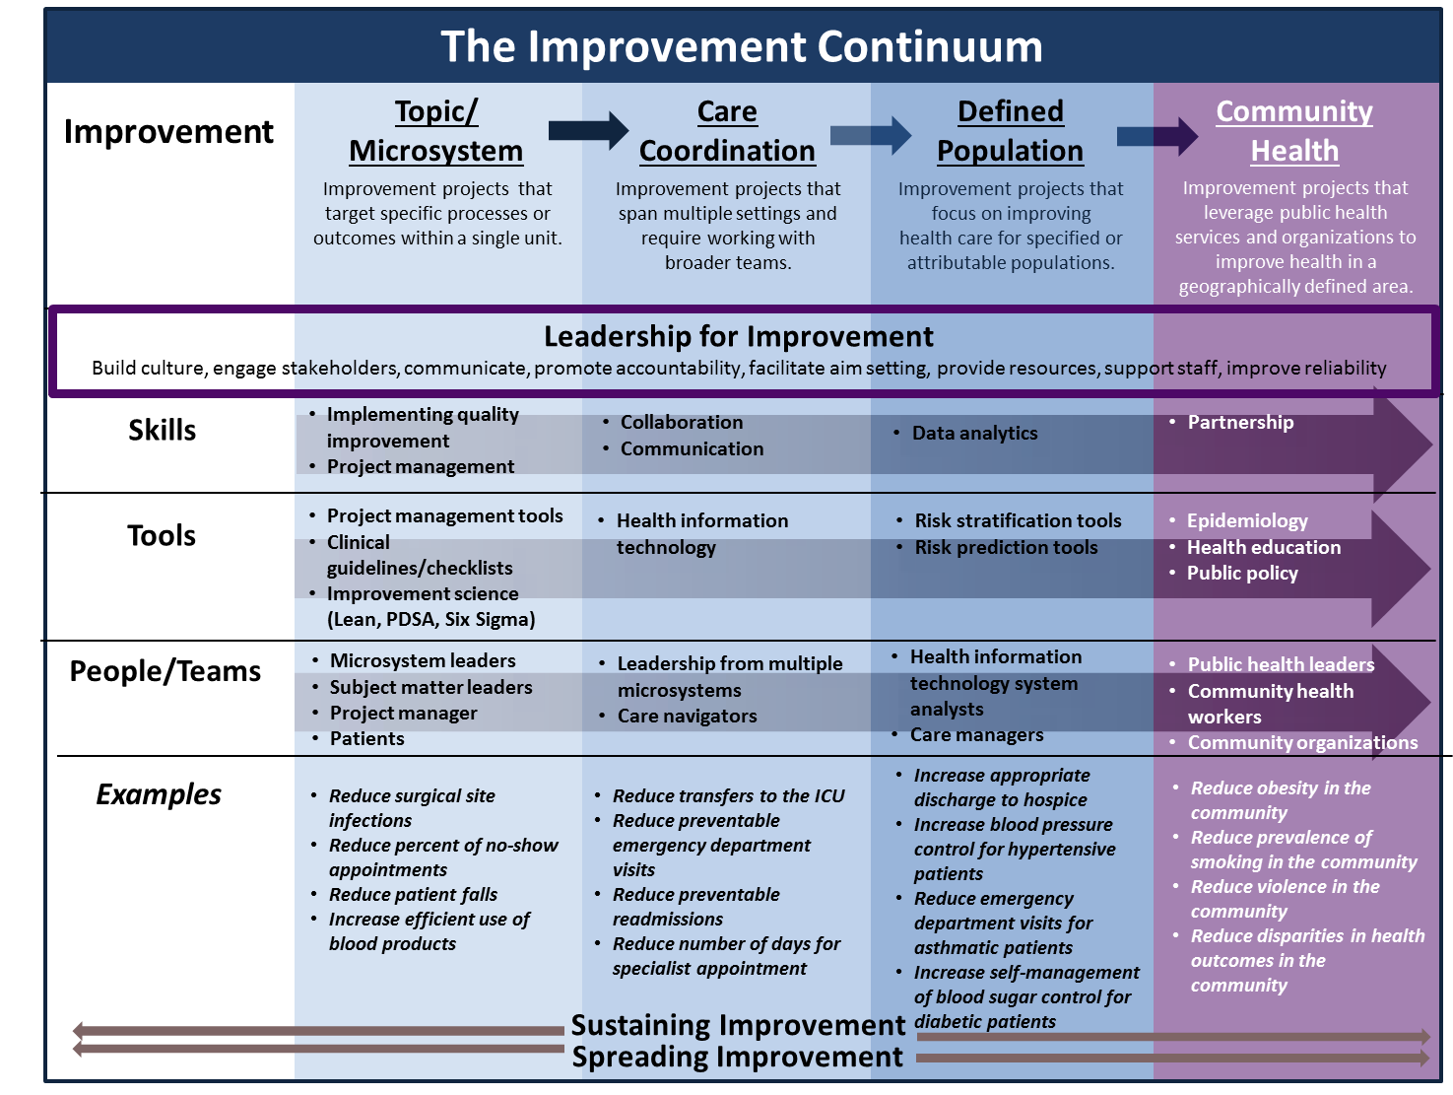
Improvement Continuum
3

Slide 5
Topic/Microsystem
Projects at the topic/microsystem level are implemented in units or departments and address a specific challenge that the unit has identified as an opportunity for improvement.
Teams need skills in both improvement science and project management.
Teams utilize project management tools, clinical guidelines or checklists and improvement science tools. (e.g., Lean, PDSA, Six Sigma).
Teams include microsystem leaders, subject matter leaders, a project manager and patients.
4

Slide 6
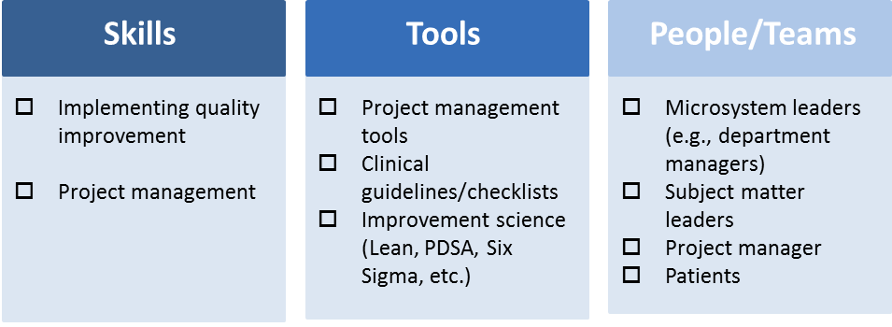
Topic/Microsystem
Examples:
  Reducing surgical site infections
  Reducing the percent of no-show appointments
  Reducing adverse drug events
  Increasing the efficient use of blood products
5

Slide 7
Care Coordination
Projects at the care coordination level aim to address the consequences of a highly fragmented care system.
Care coordination requires skills in collaboration and communication.
Use of health information technology tools is critical.
Teams should include leadership from multiple microsystems and care navigators.
6

Slide 8
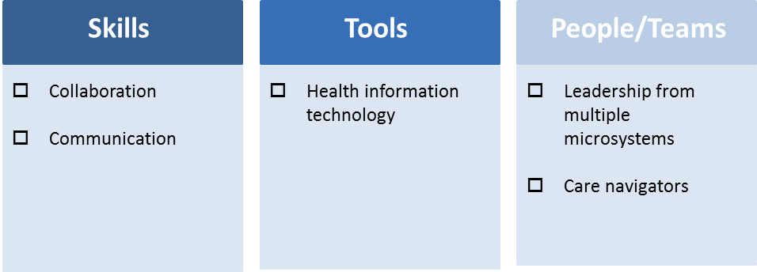
Care Coordination
Examples:
  Reducing transfers to the intensive care unit
  Reducing preventable emergency department visits
  Reducing preventable readmissions
7

Slide 9
Defined Population
Improvement at the defined population level requires building systems and processes to improve the health of a distinct population of patients.
Accountable care organizations are one model.
Defined population improvement projects require skills in data analytics.
Risk stratification and risk prediction tools help to identify high-risk, high-cost patients so that targeted interventions can be implemented.
Improvement teams at the defined population level should add health information technology system analysts and care managers to their teams.
8

Slide 10
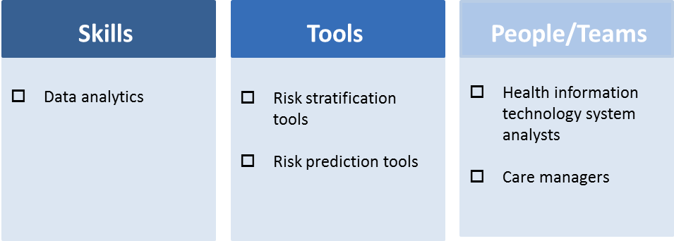
Defined Population
Examples:
  Increasing appropriate discharge to hospice
  Increasing blood pressure control for hypertensive patients
  Reducing emergency department visits for asthmatic patients
  Increasing self-management of blood sugar control for diabetic patients
9

Slide 11
Community Health
Improvement projects at the community health level leverage public health resources to improve health in a geographically defined area.
Partnership is the most important skill.
Teams will need tools in epidemiology, health education and public policy.
Teams should include public health leaders, community health workers and community organizations.
10

Slide 12
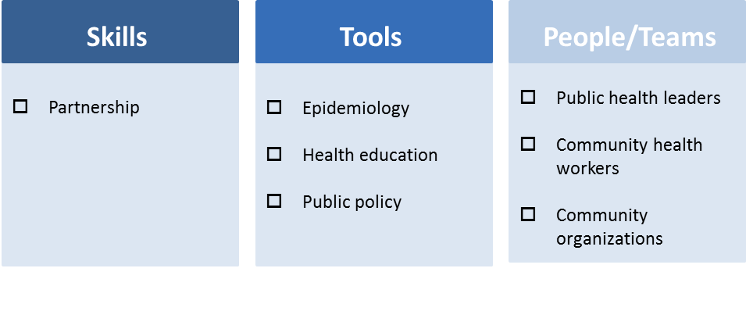
Community Health
Examples:
  Reduce obesity in the community
  Reduce prevalence of smoking in the community
  Reduce violence in the community
  Reduce disparities in health outcomes in the community
11

Slide 13
Lead Improvement Across the Continuum
The Improvement Continuum is a supplement to other improvement science and project management tools.
It is a framework to guide the development and implementation of improvement projects.
The Leadership Action Model shows how the improvement continuum can be integrated into existing improvement planning processes.
12

Slide 14
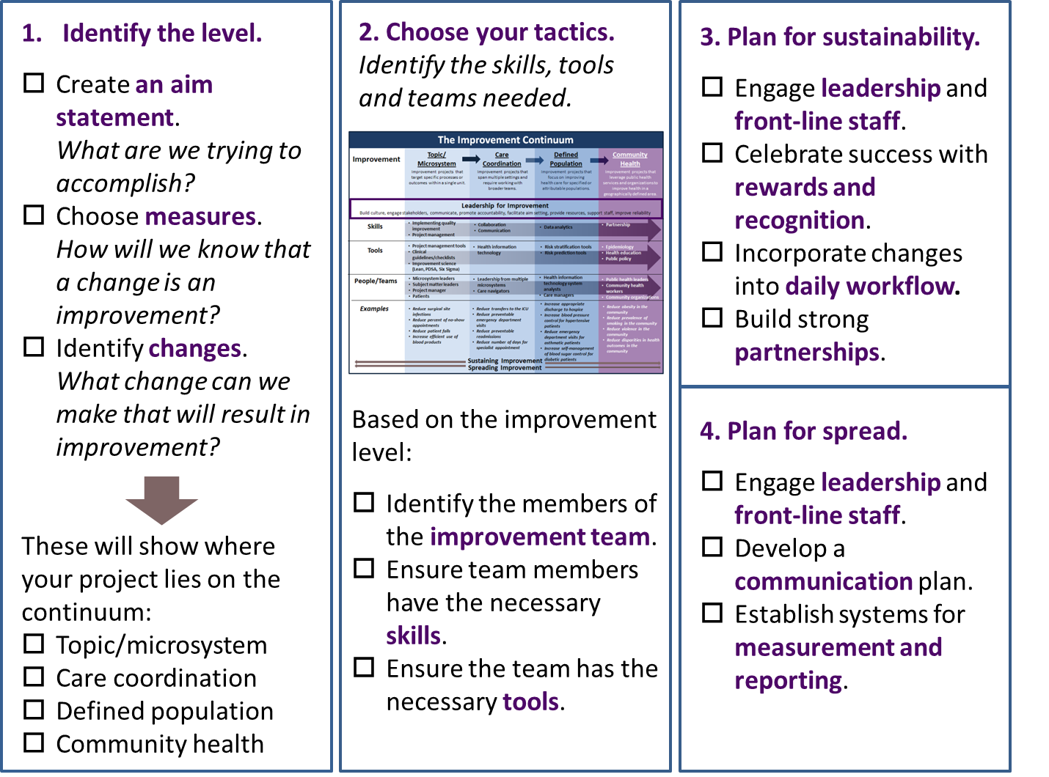
Leadership Action Model
13

Slide 15
Sustain and Spread
Improvement projects should be designed to be sustained beyond the grant, funding or PDSA cycle.
Interventions must be built into the workflow so they are not an added burden.
Relationships, partnerships and teamwork are essential for sustainability.
Identify the key mechanisms and drivers of success for the project.
These processes, protocols and frameworks can then be replicated in other environments to spread the improvement.
14

Slide 16
Resources
Process Improvement Basics
  How to Improve
  Project Tracking Tool
Improvement Toolkits
  Comprehensive Unit-based Safety Program (CUSP) toolkit
  TeamSTEPPS
  Hospital Engagement Networks
  On the CUSP: Stop HAI
  Hospitals in Pursuit of Excellence
  Institute for Healthcare Improvement
Planning for Sustainability and Spread
  How-to Guide: Sustainability and Spread
  A Sustainable Planning Guide for Healthy Communities
  Planning for Scale: A Guide for Designing Large-Scale Improvement Initiatives
  A Framework for Spread: From Local Improvements to System-wide Change
  HRET Spread Assessment Tool
Community Health
  Creating a Culture of Health
  Collaboration Primer
15

Slide 17
For more information related to health care delivery transformation, visit the
Hospitals in Pursuit of Excellence website at www.hpoe.org.
16

Slide 18
Resources: For information related to behavioral and behavioral health, visit www.hpoe.org and http://www.aha.org/psych
Accessible at: http://www.hpoe.org/improvement_continuum_october2013
Contact: hpoe@aha.org or (877) 243-0027
© 2013 American Hospital Association. All rights reserved. All materials contained in this publication are available to anyone for download on www.hret.org or www.hpoe.org for personal, noncommercial use only. No part of this publication may be reproduced and distributed in any form without permission of the publisher, or in the case of third party materials, the owner of that content, except in the case of brief quotations followed by the above suggested citation. To request permission to reproduce any of these materials, please email HPOE@aha.org.

