Slide 1
Second Curve of Health Care
April 2013

Slide 2
Metrics and Road Map for the Second Curve of Health Care
All resources available free at www.hpoe.org
Hospitals and Care Systems of the Future, 2011
http://www.aha.org/about/org/hospitals-care-systems-future.shtml
Metrics for the Second Curve, 2013
http://www.hpoe.org/resources/hpoehretaha-guides/1357
Second Curve Road Map, 2013
http://www.hpoe.org/resources/hpoehretaha-guides/1360
USERNAME: roadmap
PASSWORD: roadmap

Slide 3
Hospitals and Care Systems of the Future
Hospitals and care systems face many common challenges
Shifting demographics of patients and the workforce
Drive toward cost efficiency; access to capital for investments needed
Transition to value-based reimbursement focused on outcomes
Greater focus on population health management approaches
Increasing demand for cost and quality data transparency
Continuous advances in technology and increasing adoption speed
Increasing focus on physician leadership, alignment and engagement
Challenging variations in care
Need for clinical integration and care coordination
Growing demand for patient and family engagement

Slide 4
Hospitals and Care Systems of the Future
Must-do strategies to be adopted by all hospitals and care systems
Second curve metrics measure success of the implemented strategies
Organizational core competencies that should be mastered
Self-assessment questions to understand how well the competencies have been achieved

Slide 5
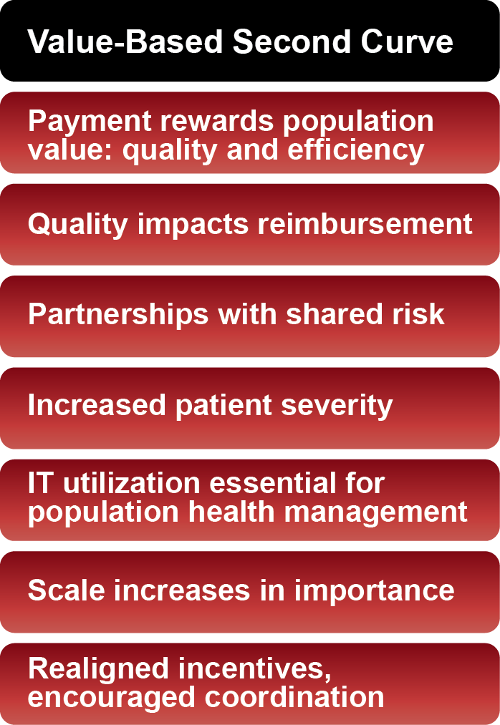
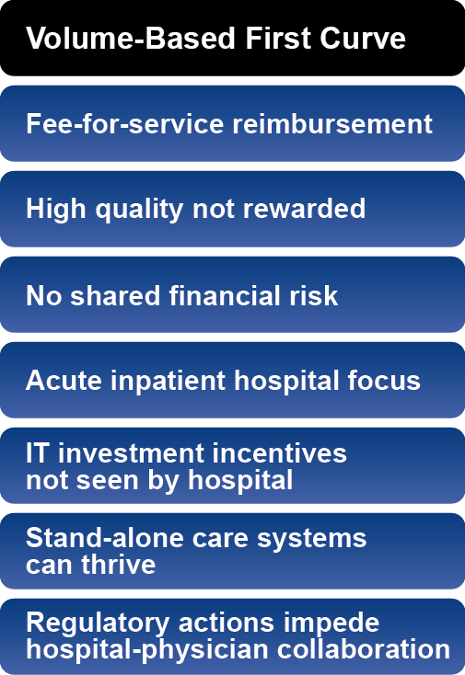
First Curve to Second Curve Markets

Slide 6
Must-Do Strategies and Core Competencies
Adoption of Must-Do
Strategies
Development of Core Competencies
Clinician-hospital alignment
Quality and patient safety
Efficiency through productivity and financial management
Integrated information systems
Integrated provider networks
Engaged employees & physicians
Strengthening finances
Payer-provider partnerships
Scenario-based planning
Population health improvement
Organizational culture enables strategy execution
Design and implementation of patient-centered, integrated care
Creation of accountable governance & leadership
Strategic planning in an unstable environment
Internal & external collaboration
Financial stewardship and enterprise risk management
Engagement of employees’ full potential
Utilization of electronic data for performance improvement

Slide 7
Second Curve Evaluation Metrics: Summary
Strategy #1: Aligning Hospitals, Physicians and Other Providers Across the Continuum of Care
Percentage of aligned and engaged physicians
Percentage of physician and other clinical provider contracts containing performance and efficiency incentives aligned with ACO-type incentives
Availability of non-acute services
Distribution of shared savings/performance bonuses/gains to aligned physicians and clinicians
Number of covered lives accountable for population health (e.g., ACO/patient-centered medical homes)
Percentage of clinicians in leadership
Strategy #2: Utilizing Evidence-Based Practices to Improve Quality and Patient Safety
Effective measurement and management of care transitions
Management of utilization variation
Reducing preventable admissions, readmissions, ED visits, complications and mortality
Active patient engagement in design and improvement
Strategy #3: Improving Efficiency through Productivity and Financial Management
Expense-per-episode of care
Shared savings, financial gains or risk-bearing arrangements from performance-based contracts
Targeted cost-reduction and risk-management goals
Management to Medicare payment levels
Strategy #4: Developing Integrated Information Systems
Integrated data warehouse
Lag time between analysis and availability of results
Understanding of population disease patterns
Use of electronic health information across the continuum of care and community
Real-time information exchange

Slide 8
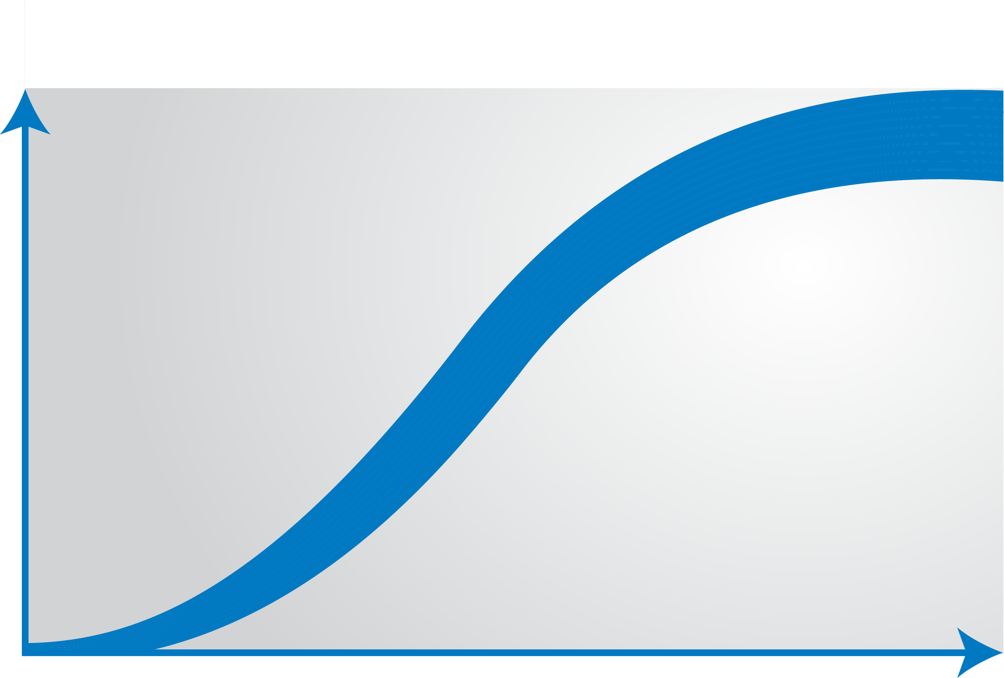
Strategy #1: Aligning Hospitals, Physicians and Other Providers Across the Continuum of Care
Percentage of aligned and engaged physicians
Percentage of physician and other provider contracts with quality and efficiency incentives
Availability of non-acute services
Distribution of shared savings / gains to aligned clinicians
Number of accountable covered lives
Percentage of clinicians in leadership
Second-Curve Metrics
Number of physicians on staff
Financial profit and loss from employed physicians
Hospitalist utilization
Number of contracts for non-acute services
First-Curve Metrics

Slide 9
Strategy #1: Aligning Hospitals, Physicians and Other Providers Across the Continuum of Care
Evaluation metrics
Percentage of aligned and engaged physicians
All affiliated physicians are aligned across all dimensions (structural relationships, financial interdependence, culture, strategic collaboration).
All affiliated and employed physicians are engaged, collaborative and participative in all major strategic initiatives.
Physician engagement survey data has been analyzed and improvement actions have been implemented with positive results.
Recruiting and contracting include an assessment of cultural fit as well as a formalized “compact” or code of conduct with mutually agreed on behaviors, values and mission for all physicians.
Percentage of physician and other clinical provider contracts containing performance and efficiency incentives aligned with ACO-type incentives
Significant level of reimbursement risk associated with new payment models (bundled payments, two-sided shared savings with both upside and downside risk, or capitation payments).
Participating in an ACO or PCMH model across a significant population, utilizing value-based incentives.
All payment contracts, payment and compensation models are linked to performance results.
Availability of non-acute services
Full spectrum of ownership, partnership or affiliation of health care services available to patients.
Distribution of shared savings/performance bonuses/gains to aligned physicians and clinicians
All clinicians’ performance is measured and they receive benchmark data on performance against peers.
Most clinicians share financial risk and rewards linked to performance, and many have received distributions of shared savings or performance bonuses.
Number of covered lives accountable for population health (e.g., ACO/patient-centered medical homes)
Active participation in a population health management initiative (e.g., chronic disease management, prevention) for a defined population.
Able to measure the attributable population for health management initiatives and a sizable population is enrolled.
Percentage of clinicians in leadership
Active clinical representation at the leadership or governance level (30 percent or above).
Physicians and nurse executives are leading development of strategic transformation initiatives.

Slide 10
Strategy #1: Aligning Hospitals, Physicians and Other Providers Across the Continuum of Care
Evaluation metrics for first to second curve
First Curve 1.0 | Transitioning in the Gap | Second Curve 2.0
Percentage of aligned and engaged physicians
Limited structural physician alignment that exists through relationships (ownership, partnership, affiliation) or other collaboration. | Moderate degree of physician alignment with some financial interdependence, structural relationships or collaboration on strategic initiatives. | All affiliated physicians are aligned across all dimensions (structural relationships, financial interdependence, culture, strategic collaboration).
Minimal level of engagement and collaboration among affiliated and employed physicians on strategic initiatives. | Moderate degree of engagement and collaboration among affiliated and employed physicians on strategic initiatives. | All affiliated and employed physicians are engaged, collaborative and participative in all major strategic initiatives.
Physicians have not been surveyed on engagement. | Physician engagement survey data has been analyzed; however, no corrective actions have been implemented. | Physician engagement survey data has been analyzed and improvement actions have been implemented with positive results.
Physician recruitment and contracting process do not include assessment or formalized agreement on cultural/mission fit. | Recruitment and contracting process for all physicians includes a cultural fit assessment and some degree of formal code of conduct linked to behavior and mission. | Recruiting and contracting include an assessment of cultural fit as well as a formalized “compact” or code of conduct with mutually agreed on behaviors, values and mission for all physicians.
Percentage of physician and other clinical provider contracts containing performance and efficiency incentives aligned with ACO-type incentives
No initiation of new payment models based on performance or value. | Moderate degree of payment models or moderate risk models (bundled payments, shared savings and capitation payments). | Significant level of reimbursement risk associated with new payment models (bundled payments, two-sided shared savings with both upside and downside risk, or capitation payments).
No participation in or exploration in adopting an ACO or patient-centered medical home model (PCMH). | Participating in a pilot ACO or PCMH program. | Participating in an ACO or PCMH model across a significant population, utilizing value-based incentives.
No payment contracts, payment models or compensation linked to performance measures. | Some contracts, payment models and compensation tied to performance rewards related to quality, efficiency and patient experience. | All payment contracts, payment and compensation models are linked to performance results.

Slide 11
Strategy #1: Aligning Hospitals, Physicians and Other Providers Across the Continuum of Care
Evaluation metrics for first to second curve (continued)
First Curve 1.0 | Transitioning in the Gap | Second Curve 2.0
Availability of non-acute services
No partnership, ownership or affiliation to offer non-acute care services. | Some ownership, partnership or affiliation to offer selected aspects of non-acute care. | Full spectrum of ownership, partnership or affiliation of health care services available to patients.
Distribution of shared savings/performance bonuses/gains to aligned physicians and clinicians
Clinicians’ performance measures are not tracked or reported. | Some clinicians’ performances are measured and they receive benchmark data on performance against peers. | All clinicians’ performance is measured and they receive benchmark data on performance against peers.
Limited portion of clinicians receive a distribution of shared savings or incentive rewards linked to performance. | Selected clinicians receive a distribution of shared savings or incentive rewards linked to performance. | Most clinicians share financial risk and rewards linked to performance, and many have received distributions of shared savings or performance bonuses.
Number of covered lives accountable for population health (e.g., ACO/patient-centered medical homes)
No patients participate in population health management or ACO initiatives. | Pilot programs on a population health management are available to patients. | Active participation in a population health management initiative (e.g., chronic disease management, prevention) for a defined population.
No ability to determine the attributable population for health management initiatives. | Limited ability to determine the attributable population for health management initiatives. | Able to measure the attributable population for health management initiatives and a sizable population is enrolled.
Percentage of clinicians in leadership
Limited clinical representation at the leadership or governance level (10 percent or less). | Stronger clinical representation at the leadership or governance level (10 to 30 percent). | Active clinical representation at the leadership or governance level (30 percent or above).
Physicians and nurse executives have limited roles in development of strategic transformation initiatives. | Physicians and nurse executives are involved to a moderate degree in leading development of strategic transformation initiatives. | Physicians and nurse executives are leading development of strategic transformation initiatives.

Slide 12
Strategy #2: Utilizing Evidence-Based Practices to Improve Quality and Patient Safety
Effective measurement and management of care transitions
Management of utilization variation
Reducing preventable admissions, readmissions, ED visits, complications and mortality
Active patient engagement in design and improvement
Second-Curve Metrics
CMS core measures for process quality
Patient satisfaction and overall experience
Facility type-specific quality and safety measures
30-day readmission rates
First-Curve Metrics

Slide 13
Strategy #2: Utilizing Evidence-Based Practices to Improve Quality and Patient Safety
Evaluation metrics
Effective measurement and management of care transitions
Fully implemented clinical integration strategy across the entire continuum of care to ensure seamless transitions and clear handoffs.
Fully implemented use of multidisciplinary teams, case managers, health coaches and nurse care coordinators for chronic disease cases and follow-up care after transitions.
Measurement of all care transition data elements. Data is used to implement and evaluate interventions that improve transitions.
Management of utilization variation
Regular measurement and analysis of utilization variances, steps employed to address variation and intervention effectiveness analyzed on a regular basis.
Providing completely transparent, physician-specific reports on utilization variation.
Regular use of evidence-based care pathways and/or standardized clinical protocols on a systemwide basis for at least 60 percent of patients.
Reducing preventable admissions, readmissions, ED visits, complications and mortality
Regular tracking and reporting on all relevant patient safety and quality measures.
Data commonly used to improve patient safety and quality, with positive results observed.
Active patient engagement in design and improvement
Regular use of patient-engagement strategies such as shared decision-making aids, shift-change reports at the bedside, patient and family advisory councils and health and wellness programs.
Regular measurement or reporting on patient and family engagement, with positive results.

Slide 14
Strategy #2: Utilizing Evidence-Based Practices to Improve Quality and Patient Safety
Evaluation metrics for first to second curve
First Curve 1.0 | Transitioning in the Gap | Second Curve 2.0
Effective measurement and management of care transitions
Limited patient education and coordination after discharge. | Moderate degree of patient outreach and follow-up after care transition; some care coordination tools used to manage care transitions. | Fully implemented clinical integration strategy across the entire continuum of care to ensure seamless transitions and clear handoffs.
No use of team-based approaches or case managers for chronic disease management or follow-up for at-risk patients after discharge. | Limited use of multidisciplinary teams, case managers or nurse care coordinators for chronic disease cases and follow-up care. | Fully implemented use of multidisciplinary teams, case managers, health coaches and nurse care coordinators for chronic disease cases and follow-up care after transitions.
Limited measurement of care transition data. | Some measurement of care transition data; no analysis conducted on the results. | Measurement of all care transition data elements. Data is used to implement and evaluate interventions that improve transitions.
Management of utilization variation
No measurement of utilization variation; no processes to minimize variation. | Relatively consistent measurement and analysis; limited action to address variation. | Regular measurement and analysis of utilization variances occur, steps are employed to address variation and intervention effectiveness is analyzed on a regular basis.
Limited reporting on utilization variation with limited transparency or physician specificity. | Utilization variation reports created with moderate transparency or physician specificity. | Provides completely transparent, physician-specific reports on utilization variation.
No evidence-based practices or protocols to standardize care practices. | Some use of data-driven analysis to reduce variation in clinical practice and identify opportunities for standardization. | Regular use of evidence-based care pathways and/or standardized clinical protocols on a systemwide basis for at least 60 percent of patients.
Reducing preventable admissions, readmissions, ED visits, complications and mortality
No comprehensive tracking of patient safety or quality metrics. | Limited tracking of patient safety or quality measures; some analysis of results. | Regular tracking and reporting on all relevant patient safety and quality measures.
No review process on quality performance for any care settings. | Simple review process on quality performance in certain care settings. | Data commonly used to improve patient safety and quality, with positive results observed.
Active patient engagement in design and improvement
Provides various sources of patient education and information, but lacking a comprehensive patient engagement strategy. | Uses various patient surveys; no in-depth analysis or connection to engagement strategies is made. | Regular use of patient-engagement strategies such as shared decision-making aids, shift-change reports at the bedside, patient and family advisory councils and health and wellness programs.
No regular measurement or reporting on patient and family engagement. | Some regular measurement or reporting on patient and family engagement, with limited results. | Regular measurement or reporting on patient and family engagement, with positive results.

Slide 15
Strategy #3: Improving Efficiency through Productivity and Financial Management
Expense per episode of care
Shared savings, financial gains or risk-bearing arrangements from performance-based contracts
Targeted cost reduction or risk management goals
Management to Medicare payment levels
Second-Curve Metrics
Staffing ratios
Cost per inpatient stay (med/surg)
Operating margin
Length of stay
First-Curve Metrics

Slide 16
Strategy #3: Improving Efficiency through Productivity and Financial Management
Evaluation metrics
Expense-per-episode of care
Tracking expense-per-episode data across every care setting and a broad range of episodes to understand the true cost of care for each episode of care.
Shared savings, financial gains or risk-bearing arrangements from performance-based contracts
Measuring, managing, modeling and predicting risk using a broad set of historical data across multiple data sources (e.g., clinical and cost metrics, acute and non-acute settings).
Implementing a financial risk-bearing arrangement for a specific population (either as a payer or in partnership with a payer).
Targeted cost-reduction and risk-management goals
Implemented targeted cost-reduction or risk-management goals for the organization.
Instituted process re-engineering and/or continuous quality-improvement initiatives broadly across the organization and demonstrated measurable results.
Management to Medicare payment levels
Projected financial impact of managing to future Medicare payment levels for the entire organization; cost cuts to successfully manage at that payment level for all patients.

Slide 17
Strategy #3: Improving Efficiency through Productivity and Financial Management
Evaluation metrics for first to second curve
First Curve 1.0 | Transitioning in the Gap | Second Curve 2.0
Expense-per-episode of care
No tracking of expense-per-episode of care in any setting. | Tracks expense-per-episode data in selected care settings or certain episodes. | Tracks expense-per-episode data across every care setting and a broad range of episodes to understand the true cost of care for each episode of care.
Shared savings, financial gains or risk-bearing arrangements from performance-based contracts
Lacks data or financial risk modeling tools resulting in limited ability to manage or measure risk. | Moderate ability to manage and measure risk (limited data collection, limited data analytics or limited ability to accept risk payment arrangements). | Measures, manages, models and predicts risk using a broad set of historical data across multiple data sources (e.g., clinical and cost metrics, acute and non-acute settings).
No financial risk (either as a payer or in partnership with a payer). | Evaluating a financial risk-bearing arrangement for a specific population (either as a payer or in partnership with a payer). | Implementing a financial risk-bearing arrangement for a specific population (either as a payer or in partnership with a payer).
Targeted cost-reduction and risk-management goals
No targeted cost-reduction or risk-management goals for the organization. | Created targeted cost-reduction or risk-management goals for specific services or departments. | Implemented targeted cost-reduction or risk-management goals for the organization.
No process or continuous quality-improvement interventions incorporated (Lean, Six Sigma, etc.). | Initiated process or quality-improvement interventions and captured initial data on the interventions. | Instituted process re-engineering and/or continuous quality-improvement initiatives broadly across the organization and demonstrated measurable results.
Management to Medicare payment levels
No projections on the financial impact of managing to future Medicare payment levels. | Projected financial impact of managing to future Medicare payment levels for a limited scope of care settings. | Projected financial impact of managing to future Medicare payment levels for the entire organization; cost cuts to successfully manage at that payment level for all patients.

Slide 18
Strategy #4: Developing Integrated Information Systems
Integrated data warehouse
Lag time between analysis and results
Understanding of population disease patterns
Use of electronic health information across the continuum of care
Real-time information exchanges
Second-Curve Metrics
Number of health information technology systems implemented
Data extracted
Information exchange across providers
First-Curve Metrics

Slide 19
Strategy #4: Developing Integrated Information Systems
Evaluation metrics
Integrated data warehouse
Fully integrated and interoperable data warehouse, incorporating multiple data types for all care settings (clinical, financial, demographic, patient experience, participating and non-participating providers).
Lag time between analysis and availability of results
Real-time availability for all data and reports through an easy-to-use interface, based on user needs.
Advanced data-mining capabilities with the ability to provide real-time insights to support clinical and business decisions across the population.
Advanced capabilities for prospective and predictive modeling to support clinical and business decisions across the population.
Ability to measure and demonstrate value and results, based on comprehensive data across the care continuum (both acute and non-acute care).
Understanding of population disease patterns
Robust data warehouse, including disease registries and population disease patterns to identify high-risk patients and determine intervention opportunities.
Thorough population data warehouse that measures the impact of population health interventions.
Use of electronic health information across the continuum of care and community
Fully integrated data warehouse with advanced data mining capabilities that provides real-time information in order to identify effective health interventions and the impact on the population.
Real-time information exchange
Full participation in a health information exchange and utilizing the data for quality improvement, population health interventions and results measurement.

Slide 20
Strategy #4: Developing Integrated Information Systems
Evaluation metrics for first to second curve
First Curve 1.0 | Transitioning in the Gap |  | Second Curve 2.0
Integrated data warehouse
No data integration across continuum of care. |  | Possesses a data warehouse with a limited amount of data sources (e.g., acute care and some non-acute care data). | Fully integrated and interoperable data warehouse, incorporating multiple data types for all care settings (clinical, financial, demographic, patient experience, participating and non-participating providers).
Lag time between analysis and availability of results
Data analysis and reporting not widely available or easily accessible. |  | Limited amount of standard reports on key performance measures available. | Real-time availability to all data and reports through an easy-to-use interface, based on user needs.
No data-mining capabilities. |  | Limited data-mining capabilities on a subset of data or for certain delivery settings. | Advanced data-mining capabilities with the ability to provide real-time insights to support clinical and business decisions across the population.
No predictive modeling capabilities. |  | Limited predictive modeling capabilities on a subset of data or for certain delivery settings. | Advanced capabilities for prospective and predictive modeling to support clinical and business decisions across the population.
No ability to measure or demonstrate value and results. |  | Limited ability to measure and demonstrate value and results. | Ability to measure and demonstrate value and results based on comprehensive data across the care continuum (both acute and non-acute care).
Understanding of population disease patterns
No examination of population disease patterns. |  | Limited examination of population disease patterns (e.g., focus on certain diseases or targeted population groups). | Robust data warehouse, including disease registries and population disease patterns to identify high-risk patients and determine intervention opportunities.
No ability to identify high-risk/high-utilization patients. |  | Limited ability to identify high-risk/high-utilization patients and conduct interventions. | Thorough population data warehouse that measures the impact of population health interventions.
Use of electronic health information across the continuum of care and community
Limited electronic health information, limited interoperability between systems. |  | Most health information is available electronically, 80 percent of patient information is in a certified EHR, some interoperability exists between systems and limited population health data is included. | Fully integrated data warehouse with advanced data mining capabilities that provides real-time information in order to identify effective health interventions and the impact on the population.
Real-time information exchange
No participation in a regional or other type of health exchange. |  | Partial participation in a regional or other type of health exchange. | Full participation in a health information exchange and utilizing the data for quality improvement, population health interventions and results measurement.

Slide 21
Other Must-Do Health Care Transformation Strategies (Strategies #5-10)
Other Must-Do Strategies
Joining and growing integrated provider networks and care systems
Educating and engaging employees & physicians to create leaders
Strengthening finances to facilitate reinvestment and innovation
Partnering with payers
Advancing an organization through scenario-based strategic, financial and operational planning
Seeking population health improvement through pursuit of the “Triple Aim” (improving patient experience of care including quality and satisfaction, improving the health of populations, and reducing the per capita cost of health care)

Slide 22
Other Must-Do Health Care Transformation Strategies (Strategies #5-10)
Evaluation metrics
Strategy Five: Joining and Growing Integrated Provider Networks and Care Systems
Care arrangements and redesigned workforces that increase integration
Primary-care service arrangements that increase coordination across the continuum of care
Post-acute care services and integration with acute-care providers
Working with partners and other organizations on integrated care delivery
Structural ownership, partnership or affiliation arrangements that enable integrated care delivery
Alignment of clinical staff and other workforce to the organization’s mission, vision, values and strategic priorities
Strategy Six: Educating and Engaging Employees and Physicians to Create Leaders
Formal leadership education program for employees, physicians and other clinicians
Formal leadership development and mentoring opportunities within the organization
Engagement of the employee population on culture and key strategic improvement initiatives
Strategy Seven: Strengthening Finances to Facilitate Reinvestment and Innovation
Identification and access to necessary capital finances for innovation initiatives
Quality-improvement initiatives tied to financial goals
Strategy Eight: Partnering with Payers
Contracts with payers aligning risk and reward
Contracts and partnerships with different payers on new initiatives to transform delivery or financing of care (commercial, regional, government, self-insured employers, etc.)
Contracts including clinical quality, patient experience/satisfaction, cost/efficiency and second-generation value indicators
Strategy Nine: Advancing an Organization through Scenario-Based Strategic, Financial and Operational Planning
Incorporation of flexible, systematic strategic planning with financial and operational capabilities
Incorporation of scenario-based planning including risk assumptions
Strategy Ten: Seeking Population Health Improvement through Pursuit of the “Triple Aim”
Implementation of the Institute for Healthcare Improvement’s Triple Aim initiative
Development of population health programs
Tracking and measurement of population health management initiatives relative to evidence-based practices

Slide 23
Copy Right
Resources: For information related to health care delivery transformation, visit www.hpoe.org.
Suggested Citation: Metrics for the Second Curve of Health Care. Health Research & Educational Trust, Chicago: April 2013. Accessed at www.hpoe.org
Contact: hpoe@aha.org (877) 243-0027
Accessible at: www.hpoe.org/future-metrics-1to4
© 2013 American Hospital Association. All rights reserved. All materials contained in this publication are available to anyone for download on www.hpoe.org for personal, noncommercial use only. No part of this publication may be reproduced and distributed in any form without permission of the publisher, or in the case of third party materials, the owner of that content, except in the case of brief quotations followed by the above suggested citation. To request permission to reproduce any of these materials, please email hpoe@aha.org.

