Slide 1

Expanding Access to Behavioral Health through Hospital and CCBHC Collaboration
Unity Center for Behavioral Health and
LifeWorks NW

Slide 2
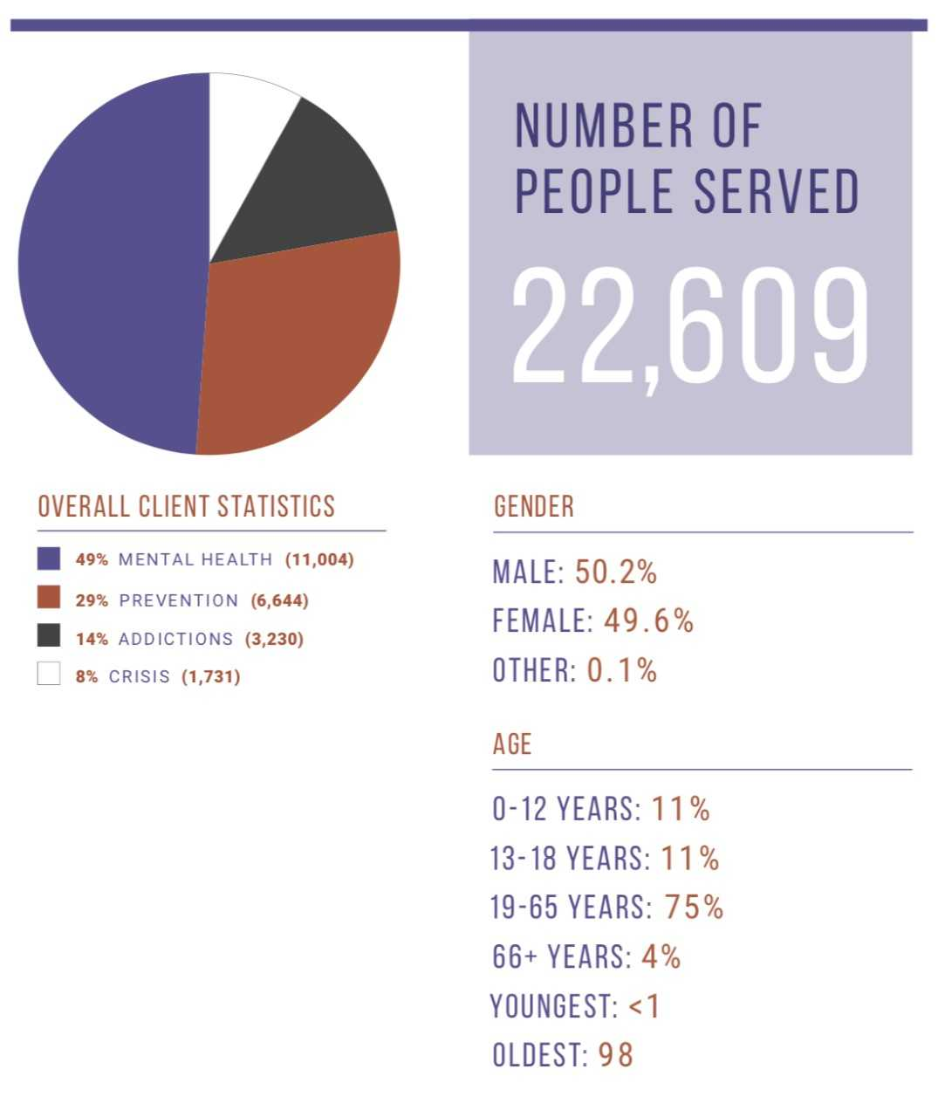
LifeWorks NW
A non-profit behavioral healthcare company
Serving the greater Portland metro area
  Offer outpatient and limited residential services
  Staff of nearly 700
  Primarily serve Medicare, Medicaid, and Uninsured

Slide 3
Unity Center for Behavioral Health
Unique collaboration between Legacy, OHSU, Adventist Health and Kaiser to provide services to the region
Community-wide effort (city, counties, state, payers, EMS, police, mental health and addictions providers- more than 30 participating agencies
Facility licensed under Legacy Emanuel Medical Center
102 inpatient beds (80 adult beds, 22 adolescent beds)
Adult Psychiatric Emergency Service (45-55 pts/day)
Strong Peer support built into structure of Unity
Built-in space for Community Providers to help navigate handoffs from Unity to community treatment and resources
Notes:
This should cover the note about community involvement
Will also talk here about Co-Location

Slide 4
History – Why?
Response to community need
Increasing efficiencies amongst local hospital systems (OHSU, Kaiser, Legacy, Adventist)
Mitigating gaps within the system
  Fragmented legal, medical and psychiatric processes and services
Decrease Emergency Room boarding and increase care experience
Reduce Inpatient admissions

Slide 5
History – How?
Built by key stakeholders within the community
    Hospitals
    Behavioral Health Providers
    Criminal Justice System
    Peers
    Oregon Health Authority
    Emergency Medical Services
    Counties
Trauma Informed Care Framework
Co-locating providers within hospital system

Slide 6
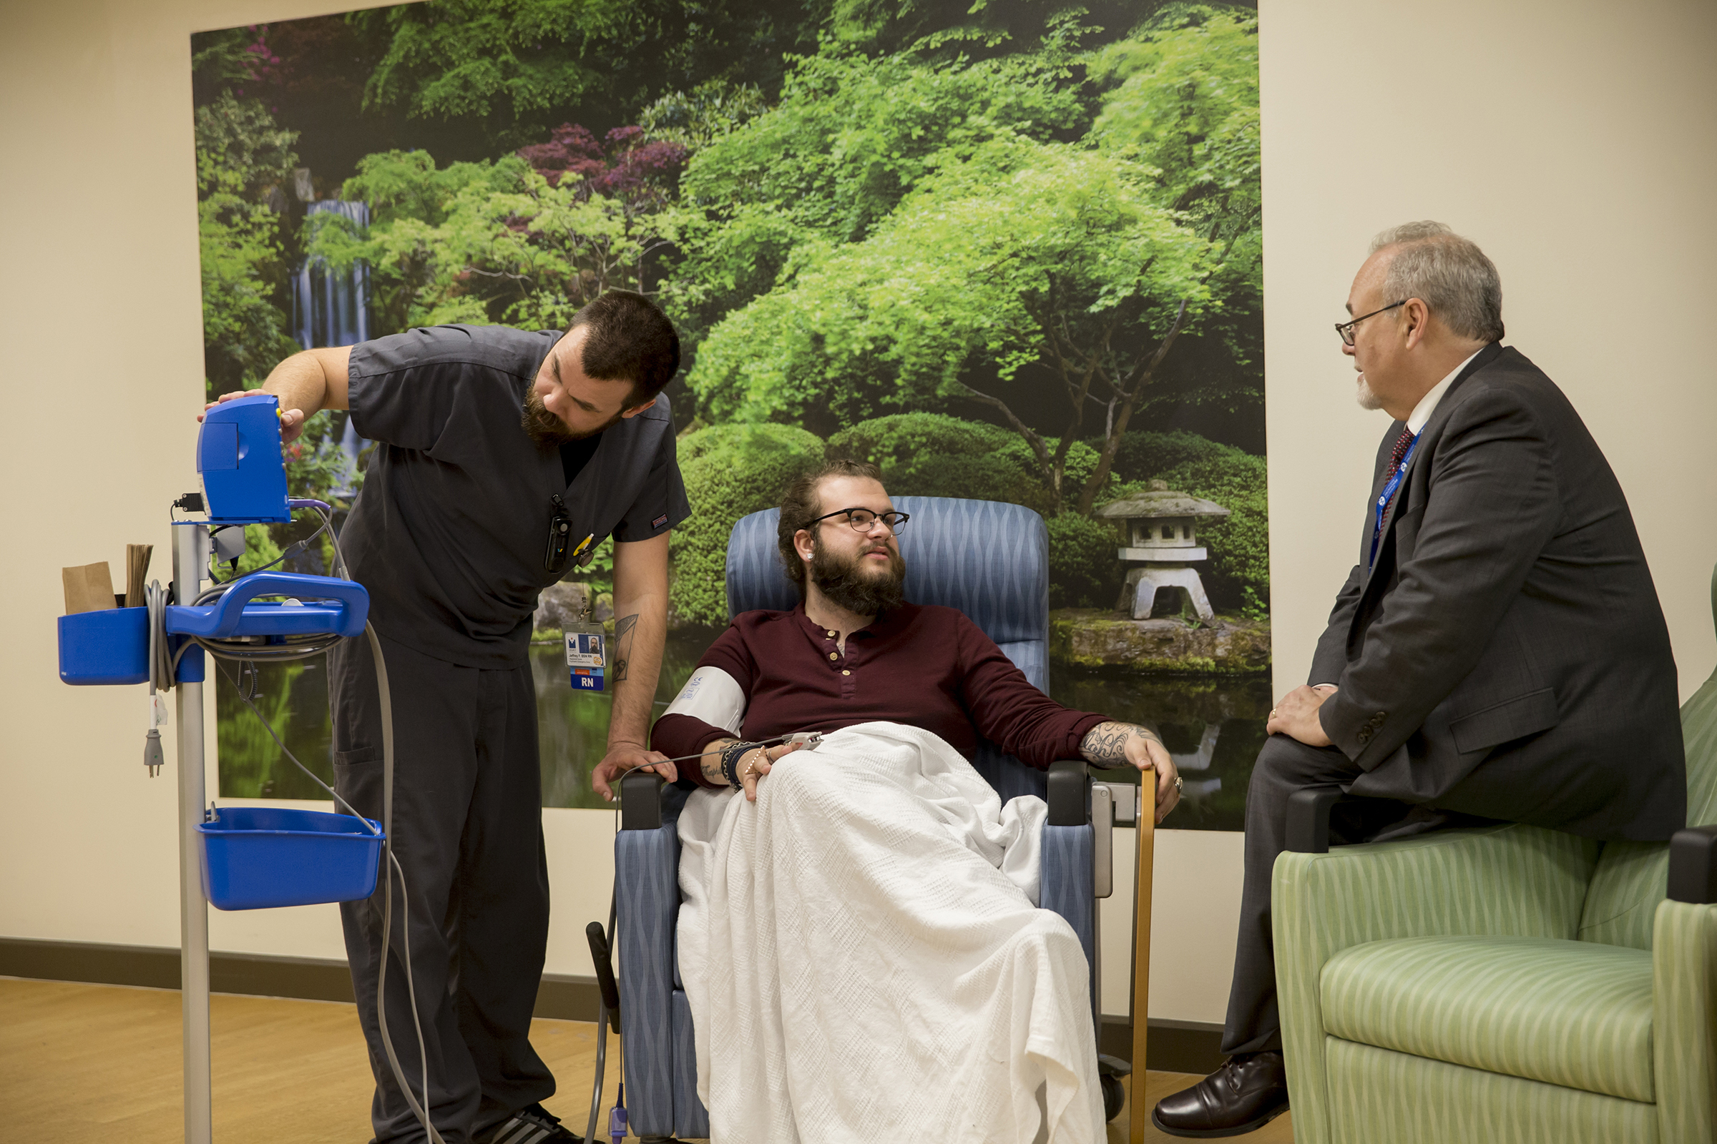
PES: Psychiatric Emergency Service
Notes:
PES built on Alameda Model
Decrease need for inpatient based
Longer period of stabilization

Slide 9
March 2019– PES Disposition
Disposition | Count | Percent
Discharge | 649 | 76.80%
Admit | 134 | 15.85%
LWBS | 52 | 6.15%
Transferred to another facility | 6 | 0.71%
other | 4 | 0.47%
Notes:
Data from: WEBI – PESBOM
Chart: PESBOM.xlsx

Slide 10
Integrated Care Model
“People with mental and substance abuse disorders may die decades earlier than the average person”
The systematic coordination of general and behavioral healthcare.
Integrating mental health, substance abuse, and primary care services produces the best outcomes and proves the most effective approach to caring for people with multiple healthcare needs
Source: What is Integrated Care? SAMHSA-HRSA Center for Integrated Health Solutions
Primary Care Provider
Client/ Patient
Hospital/ Emergency Room
Oral Care Provider

Slide 11
Integrated Care Principles
Increase the access to care
Improved patient/consumer health/mental health status & clinical outcomes
Improved patient/consumer satisfaction
Improved cost management and cost savings
Administrative simplification
Primary Care Provider
Client/ Patient
Hospital/ Emergency Room
Oral Care Provider
Source: Behavioral Health/Primary Care Integration Models, Competencies, and Infrastructure, National Council for Community Behavioral Healthcare, 2003

Slide 12
Funding
UNITY
Partners share investment
PES paid by medical benefit
Inpatient paid by MH benefit
  Payor Mix 03/2019
    Medicare 24.5%
    Medicaid 55.6%
    Commercial 19.2%
    Self Pay .8%
LifeWorks NW
  Medicaid/Medicare
  State/County
  Performance-based bonus (reduce acute care utilization)
  7-day post hospitalization
  CCBHC

Slide 13
LifeWorks NW Integrated Care
Our Focus is on Partnerships
Coordinated Separate Facilities Communicate as Necessary | Co-Located Same Facilities Transitioning to shared systems/data Face-to-face communications | Integrated Same Facilities Shared/Highly Integrated systems and data Blended Operations
✔️ | ✔️ | ✔️
Phone Paper Fax Email Secure Messaging Manual Processes | Shared System Access Connected Systems Push/Pull Shared Data (CCD/CCDA) Coordinated Processes | Shared Care Plans Integrated Business Processes and Systems ”One Team”

Slide 14
LifeWorks NW Integration with Unity
Clinical Model
Rapid Response | ITT | Psychiatric Services
Co-located Enrolled LifeWorks NW Consumers ED Diversion Transition of Care Utilizes Care Everywhere | Non Enrolled Consumers Transitions of Care Medication Bridge | Enrolled LifeWorks NW Consumers Medication Reconciliation Medical Director mtgs/Coordinated workflows

Slide 15
Working Together to Integrate
Into Outpatient Clinical Services
Open Access and Urgent Intakes
Creating Better and Timely Information Sharing
  Related to medications
  ED discharge information
    Improving transition/coordination between ED/Hospital and Outpatient Care
Integrating Mental Health, Addictions, and Physical Health
  To prevent ED/Hospital Utilization

Slide 16
Working Together
Integrating/Coordinating Intensive Treatment (ACT, ICM, ICTS)
Integrating Peer Services
  UNITY & LifeWorks NW
Addressing Community, Social, and Safety Issues that Contribute to ED/Hospitalization
  Housing, Domestic Violence, Legal Issues
Commitment Processes on-site

Slide 17
Continuous Learning and Improvement
Transitions of Care Meeting
  Monthly meeting with providers
Transportation Workgroup
Advisory Council
  Regular meeting of key stakeholders
    UNITY, Providers, Emergency Services, County, Medical School, Law Enforcement

Slide 18
Key Challenges
Network of Connectivity
  Integrate with multiple EHRs, HIEs
  Integrate with multiple extended service providers i.e. laboratories
  Integrate with multiple Collaboratives, Collectives
Blending of Medical and Behavioral Health Worlds
  Nomenclature
  Business Processes
Variance in Data Definition, Collection, and Reporting
Evolving Policy Changes at Federal, State levels
  Funding
  Reporting
Primary Care Provider
Client/ Patient
Hospital/ Emergency Room
Oral Care Provider

Slide 19
Innovation – What’s Needed
Data Exchange Standards
  Data Definitions
  Common key Identifiers for record matching
Flexibility & Configurability Designed into Data Exchange
  Design to support the network of connectivity
  Design to support integrating business processes across different organizations
    Role based, Rule based, Triggers, Escalation Policies, Data Selection
Integrated Sign-on/System Authentication

Slide 20
LifeWorks NW - What’s Next?
Identifying the Priority Business Processes and Data
  Operationally collaborative
  Healthcare service necessary
Working with Partner Network
  Identify gaps in current technologies and methods
  Develop and establish the data exchanges and technology
Establishing Partner Collaborative
  Define Data Exchange Standards
  Data Definitions
Integrated ED Diversion/Care Plans
  Utilizing Collective Medical Technology Pre-Manage Care Plans
  Developing integrated client focused care plans

Slide 21
QUESTIONS?

