Slide 1

Creating Cultures of Trauma Informed Care:
CMHCs, Hospitals & Health Systems Advancing Whole Health

Slide 2

Who is National Council for Behavioral Health?
The National Council for Behavioral Health was established 50 years ago and is the largest association in the U.S. providing mental health and addiction services through our 3100 member organizations.
Together with key partners throughout our industry, the National Council’s assertive public policy efforts have changed the face of health care in America – but our work Is nowhere near done and we need your help.
The National Council for Behavioral Health is the distributor of Mental Health First Aid in America. It is the CPR of mental health and one of the best answers to every American who asks “how can I help” be part of the solution?
The National Council works tirelessly to change the Behavioral Health community from within. We work with our members and others in the industry to transform the effectiveness and quality of care across thousands of organizations.
The National Council raises awareness and increases education 365 days a year. It hosts the largest and most powerful annual conference in the field, utilizes a network of the top medical directors throughout the country and promotes answers to the most important behavioral health questions through its array of communication platforms.

Slide 3

We are the national advocate for America’s hospitals and health systems.
OUR VISION
A society of health communities, where all individuals reach their highest potential for health.
OUR MISSION
To advance the health of all individuals and communities. The AHA leads, represents and serves hospitals, health systems and other related organizations that are accountable to the community and committed to health improvement.

Slide 4
Our History
With roots dating back to 1898, the American Hospital Association now counts among its members…
More than 5,000 hospitals, health care systems and other health care organizations
33,000 individual members
We partner with state, regional and metropolitan hospital associations to advocate for mutual members.
We operate out of offices in Washington, DC
and Chicago

Slide 5



Today's Presenters
Elizabeth Guroff, MA, LCMFT
Director, Trauma Informed Services
National Council for Behavioral Health
Wanda Vargas, PhD
Senior Psychologist
New York Presbyterian Hospital’s Family PEACE Trauma Treatment Center
Melissa Montgomery, LISW-S
Clinical Program Manager, Mayerson Center for Safe and Healthy Children
Cincinnati Children's Hospital Medical Center

Slide 6

Overview
Overview of Trauma and Trauma-Informed Principles
Components of a Trauma-Informed Organization Look Like
TIC Implementation Examples:
  Family PEACE Trauma Treatment Center at NY Presbyterian Hospital
  Cincinnati Children’s Hospital
Notes:
So in today’s training, we will discuss the Overview of trauma, what being wellness-oriented and trauma-informed looks like in our daily work and how as organizations we can become more wellness-oriented and trauma-informed.

Slide 7

What are the Benefits of Adopting
Trauma-Informed Approaches?
  Increases safety for all
  Improves the social environment
  Cares for the caregivers
  Improves the quality of services
  Reduces negative encounters and events
  Creates a community of hope, healing and recovery
  Increases success and satisfaction at work
  Promotes organizational wellness
  Improves the bottom line
Notes:
Implementing trauma-informed approaches provides individuals, organizations and communities many benefits. Those listed on the slide are just a few. Can you think of any additional benefits???

Slide 8
What is Trauma?
Definition (SAMHSA Experts 2012) includes
three key elements
event
Individual trauma results from an , series of events, or set of circumstances that is by an individual as overwhelming or life-changing and that has profound on the individual’s psychological development or well-being, often involving a physiological, social, and/or spiritual impact.
experienced
effects
Notes:
According to the Substance Abuse and Mental Health Services Administration, trauma has three key components: it is an EVENT or set of circumstances, that is EXPERIENCED directly or indirectly as overwhelming or life-changing, that has profound EFFECTS on said individual’s well-being, psychological development or has physiological, social and/or spiritual impact. So what are some things that you can think of that may fit this definition? (allow the group to provide some examples and confirm or ask for clarity if you do not understand what they are talking about).
Events and circumstances may include the actual or extreme threat of physical or psychological harm or severe life-threatening neglect for a child that imperils healthy development. These events and circumstances may occur as a single occurrence or repeatedly over time.
The individuals experience of these events or circumstances helps to determine whether it is a traumatic event. A particular event may be experienced as traumatic for one individual and not another. How the individual labels, assigns meaning to, and is disrupted physically and psychologically by an event will contribute to whether or not it is experienced as traumatic. Traumatic events by their very nature set up a power differential where one entity has power over another. They elicit a profound questions of why me? The individuals experience of these events or circumstances is shaped in the context of this powerlessness and questioning. Feelings of humiliation, guilt, shame, betrayal or silencing often shape the experience of the event.
The long-lasting adverse effects of the event are a critical component of trauma. These adverse effects may occur immediately or may have a delayed onset. The duration of the effects can be short to long term. In some situations, the individual may not recognize the connection between the traumatic events and the effects.

Slide 9


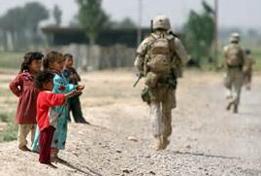






Notes:
Child maltreatment and complex trauma
Medical traumas
Serious accident or illness
Natural disaster, war, terrorism, political violence
Victim/witness to domestic, community and school violence
Domestic Violence
Traumatic grief/separation, significant loss
Historical and generational trauma
These are just a few of the categories of trauma. However, trauma, much like crisis, is subjective. If someone experiences something as traumatic, it is traumatic, whether you or anyone else views it the same way or not.

Slide 10

Trauma Shapes Our Beliefs
Worldview
Spirituality
Identity

Slide 11

Survival Mode Response
Notes:
When a traumatic event happens, we innately either fight, flight or freeze. Who here has ever been in a car accident? When it first happened, what was your immediate response? Did you freeze? Want to fight whoever hit you? Or want to leave as quickly as possible? All of the above reactions are normal. When we get scared, our body natural wants to protect us and takes over. It is one of our survival skills, much like breathing (which we do without thinking).
We activate it when we believe there's a chance we can outrun or outfight our attackers. The freeze response however, gets activated when's there's no hope.
In some respects, this response (whatever you call it) could be seen as an energy conservation device. It allowed our prehistoric ancestors to go through their day, using a modest amount of energy for mundane tasks while keeping a massive amount of energy, always on reserve, in case of emergency. If, while engaged in completing these mundane tasks, a predator were to jump out of the bushes, our ancestors would be able to – in a split second – dramatically increase their physical resources and instantly fight harder or run faster than they EVER had in their whole lives.
This response was very adaptive because it allowed our ancestors to change gears literally in the span of a single heartbeat. We can still do this today and call up this tremendous strength (the story about the woman who lifted a car off her son is NOT an urban legend) any time we need to and more importantly, turn it off when the danger passes.
I remember once when I was nine years old, I threw a water balloon at an older boy in the neighborhood. I hit him dead on and he didn't like it. He started chasing me and I was running for dear life. There was a four foot stone wall standing between me and the safety of my own backyard. I remember jumping clear over that wall even though it was about as tall as I was. That was the fight or flight response giving me the extra burst of energy I needed in an emergency.
The freeze response works differently. When we're overwhelmed by an attacker and we perceive that there is NO HOPE of surviving we tend to FREEZE. According to a story that was recently reported in the news media, a man who was visiting a national park out west actually survived a grizzly bear attack by playing dead. He sustained severe injuries during the attack but once he stopped struggling - the grizzly let him go. And it may have been what happens during the fight or flight or freeze response (which we'll discuss in minute) that allowed him to endure the pain and still manage to lie perfectly still.
The Autonomic Nervous System (ANS)
This graphic shows both the sympathetic branch which revs us up to fight or flee and the parasympathetic branch which calms us down to rest and digest. The parasympathetic branch also coordinates the freeze response.
In order to understand the fight or flight or freeze response you have to understand how the two branches of the autonomic nervous system (or ANS) work in harmony with each other to deal with the threats we face and then recover. Our ANS is a network of nerve fibers that extends throughout the body connecting the brain with various organs and muscle groups in order to coordinate the two branches of this response.
The sympathetic branch activates the fight or flight response. It tells the heart to beat faster, the muscles to tense, the eyes to dilate and the mucous membranes to dry up. All so you can fight harder, run faster, see better and breathe easier than you would without this response. And remember, this response kicks in for real threats and imagined ones in as little as 1/20th of a second: Less than the amount of time between two beats of the heart.
The parasympathetic branch activates the relaxation response. It tells the body, OK, you can relax now. The danger has passed. No need to be on alert anymore.
Whenever we yawn, or stretch or feel our muscles relaxing after a workout, this is the work of the parasympathetic branch. We may not know it, but when we turn the lights out at night, we are depending on the parasympathetic branch to allow us to sleep. Interestingly, the same neurotransmitters, hormones and pain killers that help the body relax are also dumped into the bloodstream in huge amounts when the freeze array of the response kicks in. (And it's the pain killers that allow us to lie still while being mortally wounded.)
According to psychiatrist, author and UCLA professor Daniel J. Siegel, M.D, "researchers call this the dorsal dive referring to the portion of the parasympathetic nervous system that has been activated. This response…is thought to have real benefits for an animal that is cornered by a predator. Collapse simulates death, so an attacker that eats only live prey may lose interest. Blood pressure drops precipitously in a freeze state which could also reduce blood loss from wounds. In any case, it makes the animal or person fall limply to the ground as they faint, which maintains precious blood flow to the head."
When author Dr. Peter Levine, gives lectures on surviving trauma, he shows a video of a lion chasing a baby gazelle. He is trying to show the audience exactly how the freeze response works. He explains that the video is short because the average time for a lion attack from start to finish is about 45 seconds. So he makes the additional (and very important) point that this is how long the victim's stress response (and our stress response) was designed to be activated for: Not hours or days, or even weeks on end like it does in us chronically stressed humans who don't know how to turn it off.
Of course the lion catches up to the gazelle (in less than 45 seconds) and you watch as it ruthlessly sinks its teeth into the baby animal's neck and throws it down on the ground several times, making sure it's completely lifeless. It's a game over moment if there ever was one. Then something miraculous happens. When the lion walks away, presumably to bring its cubs back to the kill, the gazelle literally comes back to life. It's as if it is waking from a deep freeze. You see it shiver all over and then it stands up and runs away, making a clean break.
For human beings, the freeze response can occur when we're terrified and feel like there is no chance for our survival or no chance for escape. It happens in car accidents, to rape victims and to people who are robbed at gunpoint. Sometimes they pass out, freeze or mentally remove themselves from their bodies, and don't feel the pain of the attack, and sometimes have no (explicit) memory of it afterwards.
That's why the fight or flight response is now called the fight, flight or freeze response. Because sometimes, when the odds are overwhelming we neither fight nor flee but simply freeze. And knowing this has special meaning in the treatment of trauma patients who, as survivors of a freeze event, experience flashbacks and other (implicit) memory fragments that can continue to haunt them for years afterwards. We'll talk about that aspect of the fight, flight or freeze response in a future article.

Slide 12
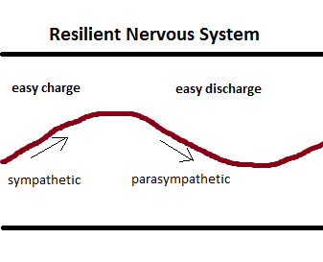
Discharge of Trauma

Slide 13
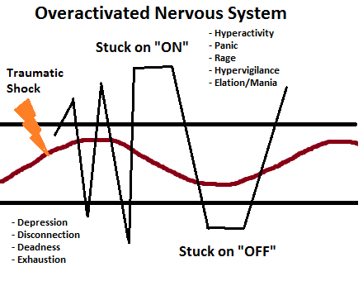
When Trauma is not discharged

Slide 14
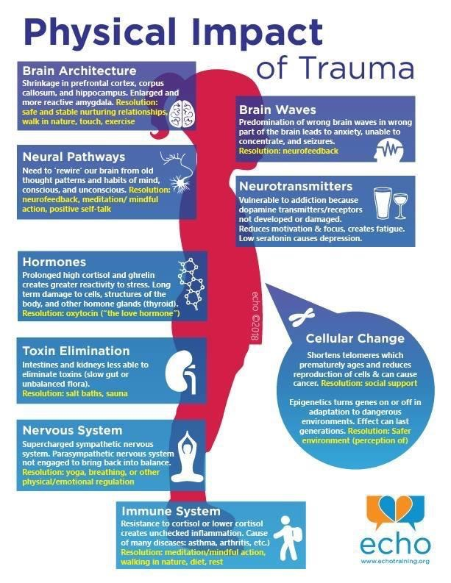

Slide 15
Impact of Trauma on Behavior Triggers
External reminders of traumatic event
  Smell
  Sound
  Sight
  Touch
  Taste
Internal reminders of traumatic event
  Emotions
  Thoughts
Notes:
Triggers can be positive or negative—apple pie cooking, smell of turkey at Thanksgiving, burning leaves in the fall, flowers in the spring, a fresh rain, (smell the strongest as the olfactory system is right next to the amygdala. But when triggers are paired with negative emotions, they become negative triggers that will connect to that negative emotion. The body will feel all the sensations that were felt at the time of the event. An example, the smell of a certain flower can be positive. However, when it is smelled at a funeral of someone you love, the feelings of grief can become associated with the smell of the flower thus it becoming a negative trigger for you. Unfortunately there is no way to possibly know all of the things that may trigger someone.
From infancy through adolescence, the body’s biology develops. Normal biological function is partly determined by environment. When a child grows up afraid or under constant or extreme stress, the immune system and body’s stress response systems may not develop normally. Later on, when the child or adult is exposed to even ordinary levels of stress, these systems may automatically respond as if the individual is under extreme stress. For example, an individual may experience significant physiological reactivity such as rapid breathing or heart pounding, or may "shut down" entirely when presented with stressful situations. These responses, while adaptive when faced with a significant threat, are out of proportion in the context of normal stress and are often perceived by others as “overreacting” or as unresponsive or detached.
Stress in an environment can impair the development of the brain and nervous system. An absence of mental stimulation in neglectful environments may limit the brain from developing to its full potential. Children with complex trauma histories may develop chronic or recurrent physical complaints, such as headaches or stomachaches. Adults with histories of trauma in childhood have been shown to have more chronic physical conditions and problems. They may engage in risky behaviors that compound these conditions (e.g., smoking, substance use, and diet and exercise habits that lead to obesity).
Complexly traumatized youth frequently suffer from body dysregulation, meaning they over-respond or underrespond to sensory stimuli. For example, they may be hypersensitive to sounds, smells, touch or light, or they may suffer from anesthesia and analgesia, in which they are unaware of pain, touch, or internal physical sensations. As a result they may injure themselves without feeling pain, suffer from physical problems without being aware of them, or, the converse – they may complain of chronic pain in various body areas for which no physical cause can be found.
Children who have experienced complex trauma often have difficulty identifying, expressing, and managing emotions, and may have limited language for feeling states. They often internalize and/or externalize stress reactions and as a result may experience significant depression, anxiety, or anger.. Their emotional responses may be unpredictable or explosive. A child may react to a reminder of a traumatic event with trembling, anger, sadness, or avoidance. For a child with a complex trauma history, reminders of various traumatic events may be everywhere in the environment. Such a child may react often, react powerfully, and have difficulty calming down when upset. Since the traumas are often of an interpersonal nature, even mildly stressful interactions with others may serve as trauma reminders and trigger intense emotional responses. Having learned that the world is a dangerous place where even loved ones can’t be trusted to protect you, children are often vigilant and guarded in their interactions with others and are more likely to perceive situations as stressful or dangerous. While this defensive posture is protective when an individual is under attack, it becomes problematic in situations that do not warrant such intense reactions. Alternately, many children also learn to “tune out” (emotional numbing) to threats in their environment, making them vulnerable to revictimization.
Difficulty managing emotions is pervasive and occurs in the absence of relationships as well. Having never learned how to calm themselves down once they are upset, many of these children become easily overwhelmed. For example, in school they may become so frustrated that they give up on even small tasks that present a challenge. Children who have experienced early and intense traumatic events also have an increased likelihood of being fearful all the time and in many situations. They are more likely to experience depression as well.

Slide 16

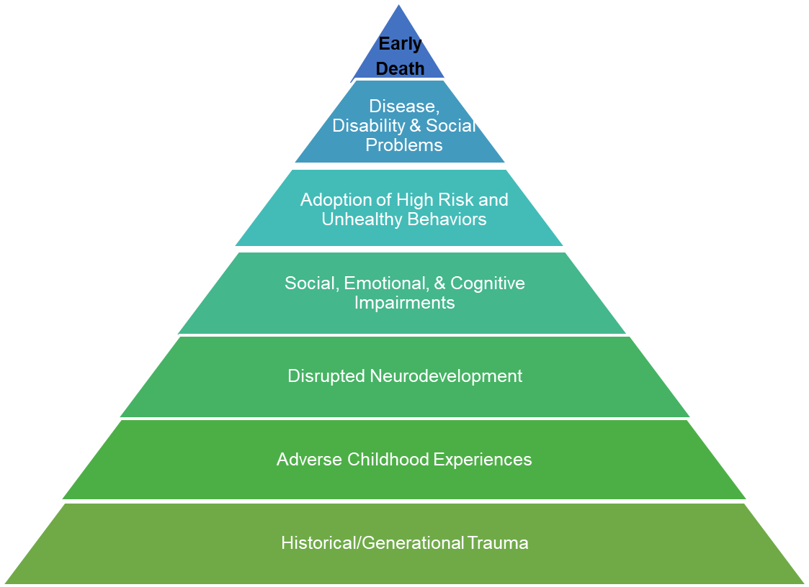
The Adverse Childhood Experience Study
Behavioral Heath at the Foundation of all Health
Over 17,000 adults studied from 1995-1997
Almost 2/3 of participants reported at least one ACE
Over 1/5 reported three or more ACEs, including abuse, neglect, and other types of childhood trauma
Major links identified between early childhood trauma and long term health outcomes,
  Including increased risk of many chronic illnesses and early death
Notes:
In the mid-1990s the Center for Disease Control and Prevention and Kaiser Permanente partnered to do a study. What they did was screen over 17000 adults, mostly middle-class, college-educated, employed, Caucasians, for 10 adverse childhood experiences also called ACEs before the age of 18. They were looking to see if there was a correlation between these childhood experiences and the negative health outcomes that they were seeing in their population. What they found was that almost 67% of the individuals screen had experienced at least one ACE and over 20% had experienced three of more ACEs before the age of 18.

Slide 17
Life-Long Physical, Mental & Behavioral Health Outcomes Linked to ACEs
Alcohol, tobacco & other drug addiction
Auto-immune disease
Chronic obstructive pulmonary disease & ischemic heart disease
Depression, anxiety & other mental illness
Diabetes
Multiple divorces
Fetal death
High risk sexual activity, STDs & unintended pregnancy
Intimate partner violence—perpetration & victimization
Liver disease
Lung cancer
Obesity
Self-regulation & anger management problems
Skeletal fractures
Suicide attempts
Work problems—including absenteeism, productivity & on-the-job injury
Notes:
Here’s just a list of potential life-long physical, mental and behavioral health outcomes that have been linked to ACEs. Look at these and think about the people in your life and that you serve. Is it possible that the people you work with, serve and know may be survivors of trauma?

Slide 18
Resilience: Ability to adapt well to stress, adversity, trauma or tragedy
Impulse control: The ability to manage expression of our feelings.
Realistic optimism: Being positive about the future and realistic
Empathy: Able to read others behavior, to understand their states, and build relationship
Reaching out: The continued drive to take on more challenges and opportunities
Emotional regulation: The ability to control our emotions, attention, and thus our behavior
Accurate identification of the cause of adversity
Self-efficacy: The sense that we can solve problems and succeed
Notes:
Another way to infuse trauma-informed care into your daily work is to promote resilience. Resilience is the process of adapting well in the face of adversity, trauma, tragedy, threats or significant sources of stress. It means "bouncing back" from difficult experiences. Research has shown that resilience is ordinary, not extraordinary. People commonly demonstrate resilience. Being resilient does not mean that a person doesn't experience difficulty or distress. Emotional pain and sadness are common in people who have suffered major adversity or trauma in their lives. In fact, the road to resilience is likely to involve considerable emotional distress. Resilience is not a trait that people either have or do not have. It involves behaviors, thoughts and actions that can be learned and developed in anyone. A combination of factors contributes to resilience. Many studies show that the primary factor in resilience is having caring and supportive relationships within and outside the family. Relationships that create love and trust, provide role models and offer encouragement and reassurance help bolster a person's resilience. Several additional factors are associated with resilience, including: The capacity to make realistic plans and take steps to carry them out. A positive view of yourself and confidence in your strengths and abilities. Skills in communication and problem solving. The capacity to manage strong feelings and impulses.
Shorthand definition: the capacity to recover from difficulties. But resilience really is comprised of a specific set of skills. The first is Emotional regulation which is the ability to control our emotions, attention, and thus our behavior. Second is Impulse control: The ability to manage expression of our feelings. Third is the accurate identification of the cause of the adversity. Fourth is self-efficacy: The sense that we can solve problems and succeed. Fifth is Realistic optimism which is Being positive and REALISTIC about the future. Sixth is Empathy which is the ability to read others behavior, to understand their states, and build relationship and lastly is Reaching out: The continued drive to take on more challenges and opportunities. The difference between resilience and adaptation is being able to adjust to new conditions. Coping. We survive

Slide 19

Paradigm Shift
We begin to ask,
“What happened to you?”
rather than
“What is wrong with you?”
We have to ask,
  “What’s strong?”
rather than
“What’s wrong?”

Slide 20
Components of a Trauma-Informed Hospital

Slide 21

We need to have…
UNIVERSAL

Slide 22









Notes:
CLICK THROUGH ALL PICTURES
Remember, trauma-informed care is about EVERYONE! Everyone is included. Everyone plays a part.

Slide 23
SAMHSA’s Four R’s
A program, organization or system that is trauma-informed
realizes the widespread impact of trauma and understands potential paths for recovery;
recognizes the signs and symptoms of trauma in clients, families, staff, and others involved with the system;
resists re-traumatization, and
responds by fully integrating knowledge about trauma into policies, procedures, practices, and settings.
Notes:
In a trauma-informed approach, all people at all levels of the organization or system have a basic realization about trauma and understand how trauma can affect families, groups, organizations, and communities as well as individuals. People’s experience and behavior are understood in the context of coping strategies designed to survive adversity and overwhelming circumstances, whether these occurred in the past (i.e., a client dealing with prior child abuse), whether they are currently manifesting (i.e., a staff member living with domestic violence in the home), or whether they are related to the emotional distress that results in hearing about the firsthand experiences of another (i.e., secondary traumatic stress experienced by a direct care professional).There is an understanding that trauma plays a role in mental and substance use disorders and should be systematically addressed in prevention, treatment, and recovery settings. Similarly, there is a realization that trauma is not confined to the behavioral health specialty service sector, but is integral to other systems (e.g., child welfare, criminal justice, primary health care, peer–run and community organizations) and is often a barrier to effective outcomes in those systems as well. People in the organization or system are also able to recognize the signs of trauma. These signs may be gender, age, or setting-specific and may be manifest by individuals seeking or providing services in these settings. Trauma screening and assessment assist in the recognition of trauma, as do workforce development, employee assistance, and supervision practices.
The program, organization, or system responds by applying the principles of a trauma-informed approach to all areas of functioning. The program, organization, or system integrates an understanding that the experience of traumatic events impacts all people involved, whether directly or indirectly. Staff in every part of the organization, from the person who greets clients at the door to the executives and the governance board, have changed their language, behaviors and policies to take into consideration the experiences of trauma among children and adult users of the services and among staff providing the services. This is accomplished through staff training, a budget that supports this ongoing training, and leadership that realizes the role of trauma in the lives of their staff and the people they serve. The organization has practitioners trained in evidence-based trauma practices. Policies of the organization, such as mission statements, staff handbooks and manuals promote a culture based on beliefs about resilience, recovery, and healing from trauma. For instance, the agency’s mission may include an intentional statement on the organization’s commitment to promote trauma recovery; agency policies demonstrate a commitment to incorporating perspectives of people served through the establishment of client advisory boards or inclusion of people who have received services on the agency’s board of directors; or agency training includes resources for mentoring supervisors on helping staff address secondary traumatic stress. The organization is committed to providing a physically and psychologically safe environment. Leadership ensures that staff work in an environment that promotes trust, fairness and transparency. The program’s, organization’s, or system’s response involves a universal precautions approach in which one expects the presence of trauma in lives of individuals being served, ensuring not to replicate it. A trauma-informed approach seeks to resist re-traumatization of clients as well as staff. Organizations often inadvertently create stressful or toxic environments that interfere with the recovery of clients, the well-being of staff and the fulfillment of the organizational mission.27 Staff who work within a trauma-informed environment are taught to recognize how organizational practices may trigger painful memories and re-traumatize clients with trauma histories. For example, they recognize that using restraints on a person who has been sexually abused or placing a child who has been neglected and abandoned in a seclusion room may be re-traumatizing and interfere with healing and recovery.

Slide 24
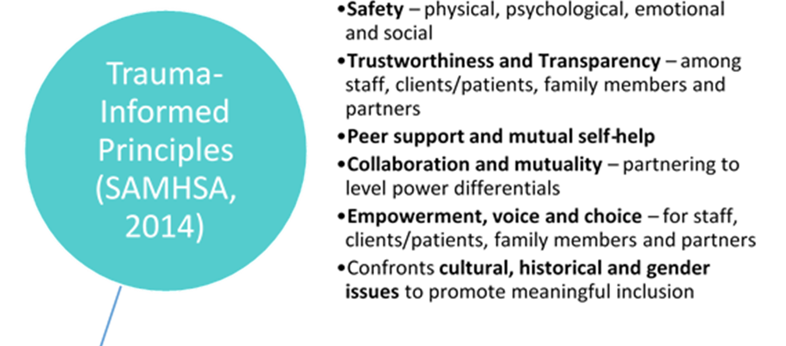

Slide 25
The 7 Domains of Trauma-Informed Care
Domain 1: Access to Early Screening & Comprehensive Assessment
Domain 2: Consumer Driven Care & Services
Domain 3: Trauma-Informed, Educated & Responsive Workforce
Domain 4: Ensure Access to Trauma-Informed, Evidence Based & Emerging Best Practices
Domain 5: Safe & Secure Environment
Domain 6: Community Outreach & Partnership Building
Domain 7: Ongoing Performance Improvement
25
Notes:
Domain 1 - Developing a respectful screening and assessment process that is routine, competently done and culturally relevant and sensitive and revisited over time
Domain 2 - Involving and engaging people who are or have been recipients of our services to play numerous roles (e.g., paid employee, volunteer, members of decision making committees, peer specialists) and meaningfully participate in planning, implementing and evaluating our improvement efforts
Domain 3 - Increasing the awareness, knowledge and skills of the entire workforce to deliver services that are effective, efficient, timely, respectful and person centered taking into consideration that service providers also have histories of trauma
Domain 4 - Increase the awareness, knowledge and skills of the clinical workforce in delivering research informed treatment services designed to address the cognitive, emotional, behavioral, substance use and physical problems associated with trauma
Domain 5 - Increase the awareness, knowledge and skills of the workforce to create a safe, trusting and healing environment as well as examining and changing policies, procedures and practices that may unintentionally cause distress and may re-traumatize (cause harm) those we serve.
Domain 6 - Recognize that the people we serve may be part of and affected by a larger service system including housing, corrections, courts, primary health, emergency care, social services, education and treatment environments such as substance use programs. We have an opportunity to engage and increase the awareness of these other service providers to the principles and practices of trauma-informed care. In this way, our efforts are less likely to be undermined by other parts of the system.
Domain 7 - The organization values a systematic approach to measuring performance on each of the core trauma-informed domains. Data is used to track, measure and analyze performance improvement in order to inform leadership and its core implementation team on areas needing improvement as well as guiding the process of sustainable change.

Slide 26
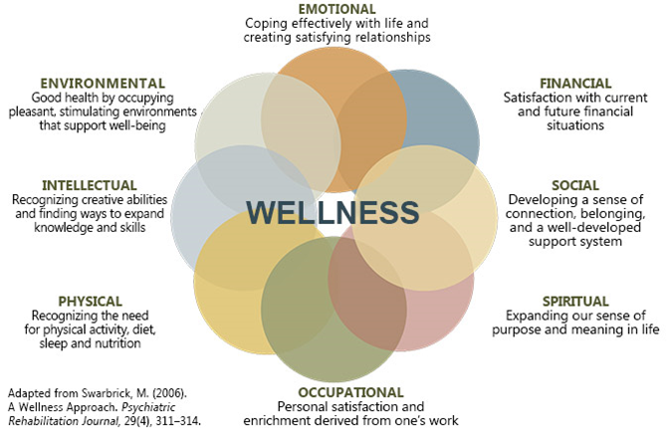
SAMHSA’s 8 Dimensions of Wellness
Notes:
The Substance Abuse and Mental Health Services Administration, also known as SAMHSA, understands that mental health is a part of a persons wellness and in order for people to recover from trauma, mental health issues or substance use issues, you must address all of the domains of wellness. If someone is financial unstable, it is hard for them to focus on their health. If they have no social connections or support system, it is hard for them to be emotionally well. All of these dimensions of wellness are interconnected and need to be addressed when working with individuals.

Slide 27
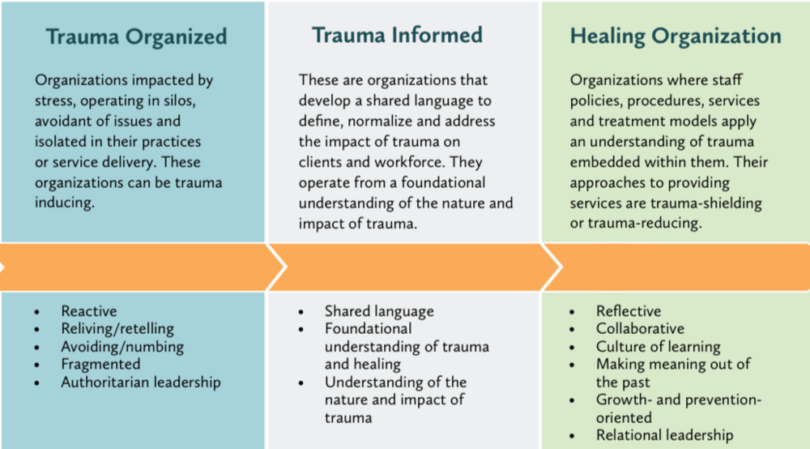

Slide 28
Family PEACE Trauma Treatment Center (FPTTC) at New York Presbyterian Hospital

Slide 29
Family PEACE Trauma Treatment Center (FPTTC)
(Preventing Early Adverse Childhood Experiences)
Mission: Dedicated to improving the safety and well-being of children and families exposed to violence/abuse and breaking the intergenerational transmission of trauma through early identification and treatment.
Holistic Mental health services for children (0-5 yrs) and their families:
  Child-Parent Psychotherapy (CPP)
  Creative Arts Therapy and group programming
  Individual therapy for caregivers and siblings
  Case management, crime victims’ assistance, on- site legal services
  Trainings: Trauma-Informed Care and Domestic Violence (DV) Screening
    Pediatric and Internal Medicine Residents
    Community Based Organizations (CBO)
  Screening for Adverse Childhood Experiences (ACEs) in 1 pediatric clinic and a Community Based Organization (CBO)
  Integrated mental health program (Healthy Steps) in 1 pediatric practice
Washington Heights Community Demographics:
  Race: 68.3% Latino; 18.8% Caucasian; 8.2% African American; 2.2% Asian
Trauma:
  Poverty: 24.1 % of people live in poverty
  Domestic Violence/Child Abuse: 25.3 cases of domestic violence reported (per 1,000 household) and 15.0 indicated cases of abuse and neglect (per 1,000 household).
  Washington Heights has the 3rd highest rate of domestic violence in Manhattan
FPTTC Program Demographics (Current Active Families N=57):
  Race: 63% Latino: ; 19% African American; 6% Caucasian; 12% Other
  Language: 65% English and 35% Monolingual Spanish
FPTTC Program Data (Jan – Oct 2019):
  Visit Volume 2019: 2,650 visits
  # of Unique Patients Served in 2019: 195 (89 Caregivers and 106 Children)
Notes:
Pediatric residents (2nd yr); Internal Medicine residents (1st yr)
Soon to be 3 CBO’s (including Ft George and El Nido)
2018 Training numbers:
Medical Residents: 36 and hospital personnel – 47 TOTAL 83
CBO Staff: 54 and Faith Based workers: 121 – TOTAL 175
Child welfare and homeless shelter (ACS, Shelter): 68
TOTAL 326
2019 Training numbers:
Medical Residents: 45 and Hospital personnel: 45 and Other: 98 (Cinema and Chat) TOTAL 188
CBO Staff: 71
TOTAL 259 thus far
Avg # of Visits per Patient: 14 visits (3.5 months)

Slide 30


FPTTC: Trauma-Informed Care (TIC) Journey
FPTTC Leadership Training:
Staff Training and Education
On-site Attorney and Partners
Diversification of Interventions
Cultural Attunement - Diversity, Inclusion & Equity
Staff Wellness Activities
Trauma Informed Trainings - Partner Agencies and Medical Personnel
Trauma-Informed Care Series for NYP Behavioral Health Department – workgroup participation
National Council for Behavioral Health Learning Community, 2018-2019
Committee – 15 participants (FPTTC, 3 CBOs), including “Voice of Lived Experience”
Bi-Weekly Meetings
Focused on:
  Domain 2 –”Consumer Driven Care and Services”
    Focus Groups, Patient Satisfaction Surveys, “Voice of Lived Experience”
  Domain 4 –”Provision of Wellness-Oriented Trauma-Informed, Evidence-Based and Emerging Best Practices”
    Patient “Clinic Bill of Rights”, Resilience/Strength-Based Practices
Notes:
Training – ACES, trauma-informed care and resilience
Extending trauma-informed lens to on-site legal services
Diversification – to meet the needs to the community, not all respond to traditional talk therapy, so have trained staff and begun to implement integrative therapies - trauma sensitive yoga, mindfulness, creative arts – music and art therapy
Infusing cultural humility into our everyday practices- staff trainings about diversity, inclusion, and equity
Staff Wellness
Training in transcendental meditation, Aromatherapy training and supplies
Staff outings
Reflective supervision and Open door policy
Led off Trauma-informed care series in August for Child and Adolescent Psychiatry Department and will participate in upcoming workgroups to work towards expansion of TIC throughout other hospital departments

Slide 31

FPTTC: Trauma-Informed Care in the Pediatric Setting
Implementation Efforts:
Clinic Staff Training
Adverse Childhood Experiences (ACEs)
Trauma-Informed Care Principles
Resident Training and Onsite Support
Staff Wellness Practices
TIC Practices
Social Justice Lens
Resilience
  Healthy Steps Model:
  Interdisciplinary
  Evidence-based (15-site national evaluation)
  Focus on healthy early childhood development and effective parenting
  On-site Healthy Steps Specialist (HSS)/ FPTTC Psychologist
  HSS available as a resource for families at anytime and can see families between appointments
  Clinic staff have access to HSS for questions and referrals
  Streamlined referrals to Family PEACE TTC
  Grant funded
Notes:
HSS
offers families positive parenting guidance
early learning strategies and resources,
screens for protective and risk factors including social determinants of health
supports families with referrals for mental health, domestic violence, food, and housing issues.
As a member of the pediatric care team, the HSS meets with families either before, during, or after well-child visits, and is available on an ongoing basis following the initial visit
integrated approach enables medical providers with little time to provide comprehensive care to their patients and increases both patient and physician satisfaction.
Additionally, the goal is to provide family-centered care in which families are empowered to make appropriate and informed decisions about the care for their children due to access to the expertise and personalized care of the HSS.

Slide 32
Healthy Steps at NYP’s Charles Rangel Clinic
Pediatric Clinic in Harlem, NY:
  4 Pediatric Attendings, 1 Pediatric Fellow
  13 pediatric residents
  ~ 6,000 annual well-child visits
  ~ 1,500 unique 0-5 year old patients seen annually
HSS onsite 3.5 days per week for families with young children ages 0-5 yrs
Three-Tiered System:
  Tier 1 - Screening (ACEs)
  Tier 2 - Short term consultations
  Tier 3 - Comprehensive follow-up: children receive services during well-child visits until the age of 5; HSS part of “team visit” with residents
Tier 1 - ACE Screening for Caregivers and Children (0 -5 years old); NOT UNIVERSAL at this time
Tier 2 - Short term consultations (2-3 sessions):
  Families with identified ongoing concern (behavioral, developmental, or social/emotional)
Tier 3 - Comprehensive follow-up for families with:
  Positive screen for ACEs, Maternal Depression or Domestic Violence (SDoH)
  Parenting/behavioral concern identified by provider
  High risk situations (reside in a shelter, child-welfare involvement, etc).
Following contact, a note is placed in EMR for provider to access
  HSS participates in weekly Medical Home meetings and communicates with providers on an ongoing basis
Notes:
Need to include that ACE screenings are not done by HSS and that they are done on paper by someone else. Also should note that they don’t get scanned into chart. We will also want to say something about full integration- maybe participation in Medical Home Model, monthly meetings locally with clinic admin, ALSO will be very important to know what the size of the clinic is so let’s find out from Evelyn how many pediatric visits they have per year and how many under 5’s, Medicaid population?, # of providers and # of residents, etc. As much info as you can get about Rangel the better. This may be something people will be interested in know
We need to be transparent about how this is being done on paper and whether it's in the waiting area or in the exam room. You will also want to be able to speak to the workflow and understand from Irvin/Evelyn/Shaylee where there is room for improvementing.

Slide 33
Healthy Steps at NYP’s Charles Rangel Clinic
June 2018 through June 2019:
Original ACEs Findings vs.
NYP Community Health Center
73%
Resident patients
27%
Attending patients
1,400 well-child visits (0-5 yr olds)
362 children seen by Healthy Steps
Number of ACEs | Orig. Study N=17,337 | NYP N=221 ADULTS
0 | 36.1% | 42.1%
1 | 26% | 26.2%
2 | 15.9% | 15.8%
3 | 9.5% | 4.1%
4+ | 12.5% | 11.8%
12% via consultation
42% ACES screen only
46% HS AND Screening

Slide 34
Healthy Steps at NYP’s Charles Rangel Clinic
June 2018 – June 2019
(N= 362)
23% Tier 3
Comprehensive follow-up
9% Tier 2
Trauma assessment
Short-Term follow-up
68% Tier 1
Ace Screening (0-5)
Family PEACE referral
Psychoeducation

Slide 35
Healthy Steps Services - Provider Experience
"I always want to spend more time with my patients and families because often, as they are leaving the office, with "hands on doorknob", they bring up psycho-social issues that I know are at the forefront of their minds, affecting their ability to take care of their family, and achieve their full potential. I know they are not hearing half of the medical advice we physicians provide when they are preoccupied with other competing psychological and social challenges. As a pediatrician, I feel it is my job to address these issues, and provide reassurance where appropriate (for ex. child development and behavior concerns), and ongoing support and monitoring.
HealthySteps makes all that possible. Just as I wouldn't expect my patients and families to achieve wellness on their own, I realize I cannot achieve what I need to in my daily work, without the support of my HealthySteps team.“
- Dr. Evelyn Berger-Jenkins (General Pediatrician ) HealthySteps Champion

Slide 36
FPTTC: Trauma Informed Care Challenges
Competing Priorities/Projects
Staffing Structure Requires Leadership Buy-In
Lack of time and resources
Difficulty changing the status quo
Culture shift requires a change in thinking and approach
This takes TIME
Notes:
Staffing - different disciplines (nurses, Mas, mds) all have their own leads and large projects require buy-in from everyone
Lack of time - (related to training, changes in workflow, etc)
- Status quo - (whether it’s workflow, culture, job roles etc)

Slide 37
NYP Family PEACE TTC Take Home Message
Education and
Training
Collaboration and Relationships
+
+
Self Assessment
Culture Shift Towards
Trauma-Informed Care

Slide 38
Cincinnati Children’s Hospital

Slide 39
Trauma Informed Care at Cincinnati Children’s Hospital
Missy Montgomery, MSW, LISW-S

Slide 40

Why?
Mayerson Center for Safe and Healthy Children
Journey Begins to Reduce Childhood Trauma

Slide 41

Wins
Divisions Engaged
Employees Trained

Slide 42

Challenges
Ground Up
Divisional Interest not Hospital Wide
Long-term Staff with High Secondary Trauma

Slide 43

Questions & Discussion

Slide 44
Contact Information
ElizabethG@TheNationalCouncil.org

Slide 45
Thank You!
Notes:
Teresa

