Slide 1
Making the Case for TeamSTEPPS®

Slide 2
What is TeamSTEPPS®?
2
Team Strategies and Tools to Enhance Performance and Patient Safety is an evidence-based teamwork system
Designed to improve:
Practical, adaptable, customizable
Provides ready-to-use materials for training and ongoing teamwork
Quality, safety and performance
Patient experience
Staff well-being and retention
Notes:
TeamSTEPPS which stands for Team Strategies and Tools to Enhance Performance and Patient Safety is based off more than 30 years of research and evidence from other high-risk industries such as the military, aviation and nuclear power. Ultimately, TeamSTEPPS aims to improve patient outcomes by enhancing communication and teamwork skills among the health care team. In addition to improving patient outcomes, it is designed to improve patient experience and staff well-being and retention. What’s unique about TeamSTEPPS is that it is practical – learners will be given tangible tools they can begin using today, it’s adaptable to integrate into any clinical or non-clinical environment and the tools are customizable to fit the needs of your teams. AHA Team Training provides ready-to-use materials for training.

Slide 3
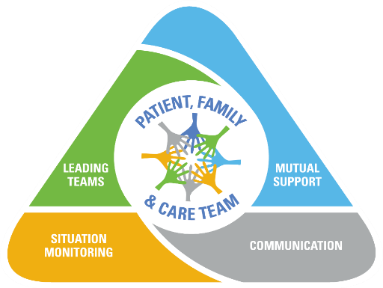
TeamSTEPPS Core Elements and Their Impact
3
Quality
Safety
Performance
Workforce
Well-Being
Patient Experience
Notes:
TeamSTEPPS is built on an evidence-based framework composed of four teachable-learnable skills: communication, team leadership, situation monitoring and mutual support. Sustainable knowledge, attitudes, and behaviors are foundational to each of these four skills. All are vital to ensuring safe, effective and patient-centered care. While each skill has direct value, it also contributes to the effective use of the other skills, making every skill mutually reinforcing. When utilized together, TeamSTEPPS can make an impact in quality/safety/performance, workforce well-being and the patient exerpeince.

Slide 4
4
THE PROBLEM

Slide 5
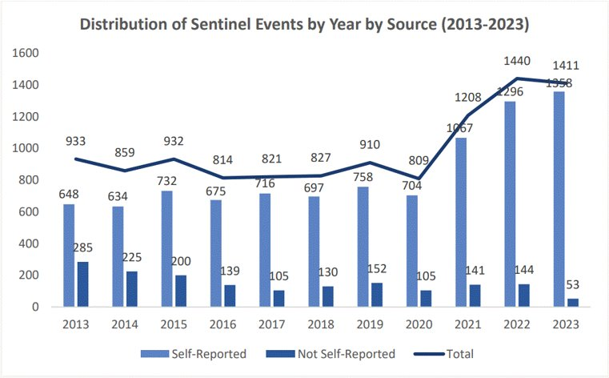
The Joint Commission Sentinel Event Data 2023 Annual Review
5
Safety
5
Notes:
Just prior to the beginning of a worldwide pandemic, we were patting ourselves on the back for making some decent progress on sentinel events which recall are those events in health care that cause death or life-altering injury. Enter COVID 19 and the sentinel event rate shot up at astronomical speed, with a whopping 1,441 sentinel events reported in 2022, a 19% increase compared to 2021 and a 78% increase from 2020. The top offenders? Patient falls (rates alone increased by 253% from 2019-2020), delay in treatment and unintended retention of a foreign object.
Reference:
https://www.jointcommission.org/-/media/tjc/documents/resources/patient-safety-topics/sentinel-event/2024/2024_sentinel-event-_annual-review_published-2024.pdf

Slide 6
The Cost of Medical Error
6
Safety
6
10-15% of health care expenditure is consumed by the direct sequelae of health care-related patient harm
About 1 in 10 dollars spent on health care is diverted to treating the effects of medical error
Patient harm reduces global economic output by trillions of dollars every year
Notes:
10-15% of health care expenditure is consumed by the direct sequelae of health care-related patient harm, to the tune of about 1 out of every 10 dollars spent. In other words, “we break it, we fix it…and absorb the price tag”. That’s money that could be going to staffing, education, more or better security, etc.
The economic repercussions include not only the direct costs associated with treating and addressing patient harm but also the broader impact on productivity and economic output.
References:
Panagioti, M., Khan, K., Keers, R. N., Abuzour, A., Phipps, D., Kontopantelis, E., ... Ashcroft, D. M. (2019). Prevalence, severity, and nature of preventable patient harm across medical care settings: Systematic review and meta-analysis. BMJ, 366, l4185.
OECD. (2020). The economics of patient safety: From analysis to action. Retrieved from https://www.oecd.org/health/health-systems/Economics-of-Patient-Safety-October-2020.pdf

Slide 7
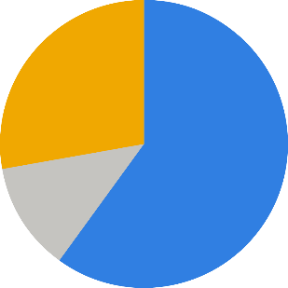
Impact on the Patient Experience
7
7
Patient Experience
Have you had what you consider to be a negative patient experience in the past 3 months?
Almost 89% of patients will stop visiting a practice after a poor patient experience
34% of patients say they are less likely to access care the next time they need it after a poor patient experience
Yes
No
I don't know
28%
60%
12%
Notes:
The hit doesn’t just abide in the realm of medical error. How we take care of patients, or how patients perceive that we’re taking care of them creates additional impact. In this 2022 Beryl Institute report, 60% of patients reported that they had had a negative patient experience in the preceding 3 months. Why does that matter? Well, it again hits our health care margin. And equally important, 34% of patients said that a poor patient experience would keep them from going to get help the next time they needed it.
Reference:
PatientEngagementHIT. (2021, August 16). 2 in 3 Healthcare Consumers Report Bad Patient Experience. PatientEngagementHIT. https://patientengagementhit.com/news/2-in-3-healthcare-consumers-report-bad-patient-experience

Slide 8
Workforce Challenges
8
Workforce
8
47% of all health care workers are planning to leave their jobs by 2025
65% of nurses say they were verbally or physically assaulted by a patient or a patient’s family member within the last year;
47% attribute it to frustration around staffing levels/care
47% of Physicians reported being burned out in 2022; these numbers rose even higher for Emergency and Critical Care
Notes:
Last but far from least, are the pressures being experienced by every member of the health care team. Already under strain, projections tell us that 47% of all health care workers are planning to leave their jobs by 2025. The stress many patients feel ends up being taken out on the those who are doing their best to care for them, often with limited human resources. So much so that 65% of nurses say they were verbally or physically assaulted by a patient or a patient’s family member within the last year. 47% attribute the assault to the patient’s frustration over staffing levels or quality of care. 47% of physicians reported being burned in 2022; these numbers rose even higher for Emergency and Critical care.
References:
Elsevier. (2022). Clinician of the Future. Elsevier. https://www.elsevier.com/connect/clinician-of-the-future
Incredible Health. (2022). STUDY: 34% of Nurses Plan to Leave their Current Role by the End of 2022. Incredible Health. https://www.incrediblehealth.com/blog/nursing-report-covid-19-2022
Han, S., Shanafelt, T. D., Sinsky, C. A., Awad, K. M., Dyrbye, L. N., Fiscus, L. C., Trockel, M., & Goh, J. (2019). Estimating the Attributable Cost of Physician Burnout in the United States. Annals of Internal Medicine, 170(11).

Slide 9
9
THE SOLUTION

Slide 10
Evidence That TeamSTEPPS Works
10
Positive change in behaviors
Process efficiencies
Cost Savings
TeamSTEPPS training at a hospital system in New Jersey was associated with increased trust and empathy among team members. Team members reported individual role empowerment and stronger cohesion within the team.
TeamSTEPPS was associated with improved operating room efficiency, boosting on-time first start rates by 21% and decreasing mean case time by 12.7 minutes.
A team-based program integrated behavioral health into every patient visit and saved a hospital system $13 million per year.
Improved Outcomes
Increased patient satisfaction
Enhanced staff satisfaction
TeamSTEPPS was implemented on a Women’s Health unit and saw a significant decrease in length of stay and the mortality index.
After efforts to improve interdepartmental teamwork at a Nashville health system, overall patient experience scores increased from a baseline of 64.41 to 79.71 one year later.
An evaluation of a TeamSTEPPS implementation in an ICU found that teamwork improved and nurses planning to stay increased from 58% to 89% over 2 years’ time.
Notes:
Though TeamSTEPPS cannot claim to be the only solution for the multifactorial issues facing healthcare today, it’s certainly a significant part of the equation. And healthcare organizations all over the nation are training their teams in TeamSTEPPS and putting it to the test. This is only a smattering of the data to showcase the effectiveness of TeamSTEPPS for cost-savings, staff retention, and most importantly, patient safety.
Reference:
Terregino, C.A., Jagpal, S., Parikh, P., Pradhan, A., Weber, P., Michaels, L., Nicastro, O., Escobar, J., & Rashid, H. (2023). Critical care teamwork in the future: the role of TeamSTEPPS® in the COVID-19 pandemic and implications for the future. Healthcare (Basel), 11(4):599.
Reiss-Brennan, B., Brunisholz, K.D., Dredge, C., Briot, P., Grazier, K., Wilcox, A., Savitz, L., & James, B. (2016). Association of integrated team-based care with health care quality, utilization, and cost. JAMA, 316(8):826-834.
Carlson, B., Graham, R., Stinson, B., & LaRocca, J. (2022). Teamwork that affects outcomes: a method to enhance team ownership. PXJ, 9(2):94-98.
Weld, L.R., Stringer, M.T., Ebertowski, J.S., Baumgartner, T.S., Kasprenski, M.C., Kelley, J.C., Cho, D.S., Tieva, E.A., & Novak, T.E. (2015). TeamSTEPPS improves operating room efficiency and patient safety. Am J Med Qual, 31(5):408-14.
Borckardt, J.J., Annan-Coultas, D., Catchpole, K., Wise, H., Mauldin, M., Ragucci, K., Scheurer, D., & Kascak, K. (2020). Preliminary evaluation of the impact of TeamSTEPPS® training on hospital quality indicators. J Interprof Educ Pract, 18.
Krivanek, M.J, Dolansky, M.A., Goliat, L, & Petty, G. (2020). Implementing TeamSTEPPS to facilitate workplace civility and nurse retention. JNPD, 36(5):259-265.

Slide 11
11
Safety
The role of teamwork
in patient safety
There is a …“consistent and statistically significant” beneficial connection between staff engagement and both patient safety culture and the rate of errors and adverse events
Programs which increase staff engagement could offer an “impactful and cost-effective means of enhancing a range of patient safety outcomes”²³
Journal of Patient Safety, 2021
Notes:
As goes the health of the team, goes the care of the patient. And as goes the care of the patient, goes the health of the organization. The data is indisputable – training to improve teamwork and communication among healthcare teams creates engagement and engagement translates into tangible results for both an organization’s safety culture and its bottom line.
Reference:
Janes G, Mills T, Budworth L, Johnson J, Lawton R. The Association Between Health Care Staff Engagement and Patient Safety Outcomes: A Systematic Review and Meta-Analysis. J Patient Saf. 2021 Apr 1;17(3):207-216.

Slide 12
Patient views of teamwork and patient satisfaction were significantly greater 2 years after TeamSTEPPS implementation in ambulatory reproductive healthcare centers, demonstrating positive long-term effects of teamwork training.
12
Patient Experience
Notes:
Significantly, team engagement impacts more than just members of the healthcare team. Patients are very tuned in to teamwork culture and it impacts how they feel about the care they receive. When patients perceive that teams are working well together, they are significantly more satisfied with their experience as this study demonstrates.
Reference:
Dodge, L. E., Nippita, S., Hacker, M. R., Intondi, E. M., Ozcelik, G., & Paul, M. E. (2020). Long‐term effects of teamwork training on communication and teamwork climate in ambulatory reproductive health care. Journal of Healthcare Risk Management, 40(4), 8–15.

Slide 13
13
Workforce
TeamSTEPPS Gets It Done for Our Workforce
✓ An evaluation of a TeamSTEPPS implementation in an intensive care unit found that teamwork improved from the time of the initial assessment to 3 months later and nurses planning to stay increased from 58% to 89% over 2 years time²⁶
✓ According to a study by the National Academy of Medicine, high-functioning teams have tremendous potential to promote clinician well-being, which is foundational to effective and efficient health care²⁷
Notes:
Patient safety and the patient experience don’t tell all of the story however. TeamSTEPPS scores high marks with workforce wellbeing and staff retention as well. When team members are given the tools to speak up, to be situational leaders, to collaborate in an environment of mutual support, their work becomes a source of empowerment and deep fulfillment– and that is what will keep them coming back day after day as this study shows. High-functioning teams are highly satisfied teams, and the research bears out time and again that a happy, well-functioning team is a safe and effective team. TeamSTEPPS can get you there.
References:
Krivanek, Mary Jo DNP, MPA, RN; Dolansky, Mary A. PhD, RN, FAAN; Goliat, Laura DNP, RN; Petty, Gayle DNP, RN. Implementing TeamSTEPPS ​to Facilitate Workplace Civility and Nurse Retention. Journal for Nurses in Professional Development 36(5):p 259-265, 9/10 2020.
Smith, C. D., C. Balatbat, S. Corbridge, A. L. Dopp, J. Fried, R. Harter, S. Landefeld, C. Martin, F. Opelka, L. Sandy, L. Sato, and C. Sinsky. 2018. Implementing optimal team-based care to reduce clinician burnout. NAM Perspectives. Discussion Paper, National Academy of Medicine, Washington, DC.

Slide 14
Team Training is About Culture
14
Culture…effects Safety
Culture…effects Patient Experience
Culture…effects Workforce Resilience & Retention
Culture drives Business Success
Notes:
At its heart, team training is about culture. It’s long been said that “culture eats strategy for breakfast”. All the strategic plans and well-designed processes in the world wont get you to goal without a healthy culture to implement and support them. Culture effects safety – healthy cultures speak up when there’s a threat to patient safety or to the team dynamic. Culture effects patient experience – healthy team culture is felt by patients and determines whether they will seek care from us again. Culture effects workforce resilience and retention – healthy team culture creates an environment of belonging and wellbeing and that is what will keep our team members coming back. Thus, it is culture that drives business success – satisfied patients and satisfied teams will drive the financial health of your organization, so you can’t afford not to be proactive there.

Slide 15
Why Use TeamSTEPPS?
15
Goal: Produce highly engaged, effective teams that optimize the use of information, people and resources to achieve the best clinical outcomes
Teams of individuals who communicate effectively and back each other up report higher staff engagement and dramatically reduce the consequences of human error
Telling isn’t training! Team skills are not innate; they must be trained
Notes:
If the best clinical outcomes possible are your goal, you have to be proactive about producing highly engaged and effective teams. They are the linchpin, and team training is the vehicle to their success. But telling isn’t training. Team skills are not innate, and healthy culture never happens accidently. Both take proactive planning, coaching and commitment to go the distance.

Slide 16
16
THE ROADMAP

Slide 17
What Makes AHA Team Training Unique?
Our People: Experienced clinical and non-clinical faculty who are experts at teaching and implementing TeamSTEPPS
Our Exclusive Curriculum: Innovative curriculum coupling proven TeamSTEPPS 3.0 tools with human-centered design thinking concepts and exercises
Our Resources: Access to AHA Team Training resources, including slide decks for Master Trainers’ ongoing use, worksheets and facilitation guides
Our Customizations: Curriculum customizations designed to address your organization-specific needs and challenges
Our Approach: Participants will walk away with a strategic and tactical implementation plan that is both manageable and scalable, fostering program ownership and providing actionable steps for sustainable success
Notes:
What makes AHA Team Training unique? We are subject matter experts where team training is concerned, committed to being evidence based and culturally relevant. We push the envelope of innovation while we holding true to time-tested skills. Your needs are unique; your team training should be too. We customize content to target your unique needs and challenges. Far from just a “training”, we walk with your teams, providing the resources and support needed to not only implement team training but to make it stick for the long haul. We settle for nothing less than sustainable success, making us the premier TeamSTEPPS training provider in the nation.

Slide 18
Our Teams Will Learn…
18
Communication – how to effectively exchange information among team members, regardless of how it is communicated.
Leading Teams – how to direct and coordinate, assign tasks, motivate team members, and facilitate optimal performance.
Mutual Support – how to assist one another, provide and receive feedback on performance, and advocate assertively when patient safety is threatened.
Situation Monitoring – how to develop common understanding of the team environment, apply strategies to monitor teammate performance and maintain a shared mental model.
Notes:
TeamSTEPPS content is organized into four teachable, learnable skills – communication, leading teams, mutual support and situation monitoring. Each of these core skills is supported by tools and strategies that enhance the learning and keep TeamSTEPPS content immensely practical and scalable. These skill building blocks are interdependent, contributing to wholistic success.

Slide 19
Custom TeamSTEPPS Advisory Services
19
TeamSTEPPS Master Training Course
Using a train-the-trainer model, we give you the foundational tools and concepts, and train your staff through this two-day training program. You will gain a team of Master Trainers ready to teach others in your organization.
Comprehensive TeamSTEPPS Programs
We help you along the way. After we deliver the two-day Master Training course, we continue to work with you for 3-6 months (or longer!) to help build internal capacity and hardwire TeamSTEPPS throughout your organization.
Notes:
Clients can choose from multiple Custom Advisory Service offerings, ranging from a 2-day Master Trainer course to a multi-year engagement. The TeamSTEPPS Master Trainer course is a “train-the-trainer” course, equipping your teams with the internal capacity needed to train, implement, and sustain TeamSTEPPS long after we are gone. We highly recommend our Comprehensive TeamSTEPPS programs as they allow for extended coaching and mentoring of your newly trained Master Trainers, including the opportunity to co-facilitate multiple 2-4 hour Essentials courses with AHA faculty for the rest of your service line or organization.

Slide 20
TeamSTEPPS Master Training Overview
20
About:
Our two-day TeamSTEPPS Master Training course is a comprehensive training that provides your teams with skills and resources for training others, and ensures they have the knowledge and know-how to implement TeamSTEPPS in their unit, department, or organization.
What You Get:
This program is taught by, and produces, Master Trainers.
TeamSTEPPS faculty are experts at both teaching the curriculum and implementing the program with clinical and non-clinical staff. AHA Team Training will also provide:
Administrative support and materials including TeamSTEPPS pocket guides
Digital and hard copies of faculty slides
Registration support for your attendees
Master Trainer certificate and digital badge
Continuing education credit (13 credits)
Pre- and post-assessment of organizational culture
1-hour post-training coaching call
Notes:
The 2-day Master Trainer course is our entry level offering but contains everything you need to train up a cadre of Master Trainers, equipped to train others in your organization. In addition to the TeamSTEPPS Fundamentals, participants will work through a series of human centered design canvases, developing a strategic gameplan for the spread of TeamSTEPPS to their team or organization and their first TeamSTEPPS “quick win”.

Slide 21
Comprehensive TeamSTEPPS Programs Overview
21
About:
This program includes the two-day TeamSTEPPS Master Training course and provides additional support and training over a 3-6 month period (or longer!), setting your organization up to have a successful and sustainable TeamSTEPPS program long after we leave.
Comprehensive Training Programs Are:
Designed to meet you where your organization is at to provide customized solutions in order to support your own Master Trainers and Champions
Completely customizable. Check out examples of our most popular options: 3-month, 6-month, and even multi-year programs.
Notes:
Our comprehensive TeamSTEPPS programs are meant to ensure sustainable success. It is not uncommon for hospitals and health systems to invest in
training individuals as Master Trainers, only to find they require more support and coaching to be successful. Ongoing advisory services provide phased support, reinforcing TeamSTEPPS tools and concepts while guiding your organization in the development of the internal capacity and ownership needed for long-term success.

Slide 22
Sample 3-Month Program
22
On-Site Training One: 30-40 participants are trained as Master Trainers across two days for the first on-site training, allowing participants to experience, and learn the tools while developing the skills to train, implement and coach at their hospital or health system.
Virtual Coaching: Faculty will meet with the new Master Trainers monthly to check-in on progress, help troubleshoot and consult on their TeamSTEPPS presentation and/or implementation program.
On-Site Training Two: Faculty will come back for another 2-day trip to co-facilitate 2 days of 4-hour TeamSTEPPS Essentials courses to increase spread across the organization.
Notes:
The 3-Month program is our most popular Advisory Services offering. This program capitalizes on the training received in the 2-day course through continued coaching and mentoring of your newly trained Master Trainers. Virtual monthly coaching calls allow Master Trainers to share successes and challenges with their TeamSTEPPS implementation and receive invaluable feedback from AHA faculty on the organization’s training plan. At then end of 3 months, AHA faculty return for a second onsite trip to co-facilitate abbreviated “TeamSTEPPS Essentials” courses with your Master Trainers for additional staff in your organization. This has the dual benefit of further equipping your Master Trainers to be competent and confident facilitators while deepening the spread of TeamSTEPPS across the service line or organization.

Slide 23
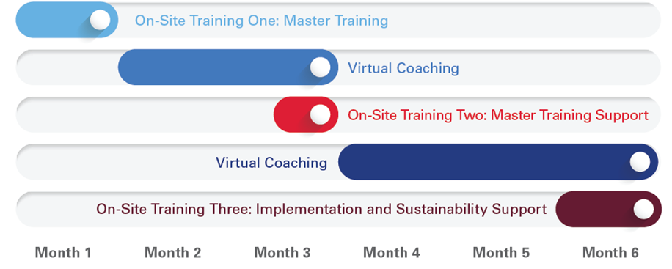
23
Sample 6-Month Program
On-site Training One, Virtual Coaching, and On-Site Training Two as outlined in the previous sample plus...
Virtual Coaching: Faculty will meet with the new Master Trainers monthly to check-in on progress, help troubleshoot and consult on their TeamSTEPPS presentation and/or implementation program.
On-Site Training Three: This trip provides support for Master Trainers and hospital leadership as they work to implement and spread TeamSTEPPS programs across the organization, including creating and implementing strategic plans for sustainability.
Notes:
The 6-month Comprehensive Program includes everything listed in the 2-day Master Trainer course and the 3 month engagement plus a “double down” on coaching and mentoring opportunities for your Master Trainers. Virtual coaching calls will continue monthly during the 6 month engagement, allowing for expanded content for furthering spread and sustainability. AHA Team Training’s expert faculty will return for a 3rd onsite visit to co-facilitate additional TeamSTEPPS Essentials courses, continuing to hone the skills of your Master Trainers and deepen the spread of TeamSTEPPS across your organization. AHA Faculty can also work with your organizational TeamSTEPPS Change Team, assisting with the creation and implementation of strategic plans for sustainability. This further ensures your TeamSTEPPS implementation will experience sustainable success long after we’re gone.

Slide 24
Multi-Year Program
24
In-depth Assessment Planning:
AHA faculty work with organizational leaders to identify unit specific challenges for the development of customized training materials. Planning begins for identification and evaluation of quality measures that will be impacted by team training.
Service Line Training & Implementation:
On-site Training One, Virtual Coaching, and On-Site Training Two as outlined in the previous 3-month sample for first service line area of implementation, followed by…
Systematic training and implementation roll-out across remaining service lines. Faculty return to repeat the process for other service line areas. Timing and number of trips is customizable to client and may be spread over months to years.
Sustainability Planning:
AHA Faculty work with Master Trainers and hospital leadership to develop a tactical and strategic plan for sustainability, such as the development of TeamSTEPPS Action Councils and guidance on embedding TeamSTEPPS training into new hire orientation and onboarding.
AHA Faculty conduct virtual or on-site specialty workshops on topics of client choice addressing implementation or sustainability hurdles or the needs of a particular service line.
Notes:
Larger organizations will appreciate the opportunity to have AHA faculty support throughout the 1-2 years it may take to achieve critical mass with their TeamSTEPPS training and implementation. With a year-long or multi-year program, AHA faculty can provide in-depth assessment planning, including the identification of quality metrics that will be impacted by TeamSTEPPS training. A phased approach allows for the training of multiple service lines while continuing to coach and mentor your increasing pool of Master Trainers. AHA faculty can provide specific guidance on the development of TeamSTEPPS Action Councils, embedding TeamSTEPPS into new employee onboarding, and the development of a coaching program. From the planning stage through sustainment, AHA Team Training will partner with your organization as you journey to high reliability and sustainable success.

Slide 25
Ready to transform your team of experts into an expert team?
AHA Team Training
www.aha.org/teamtraining
American Hospital Association – Center for Health Innovation
Ph. (312) 422-2609 • TeamTraining@aha.org

Slide 26
26
APPENDIX
Notes:
Feel free to utilize the additional data we have compiled in the following slides.

Slide 27
The Problem
27
Current state of patient safety:
In 2021, the serious safety events reported to the Joint Commission reached the highest annual level seen since reporting began in 2007¹
Consequences of poor patient experience:
Almost 89% of patients will stop visiting a practice after a poor service experience²
35% of survey respondents said well-coordinated care and communication between medical providers and their personnel is important to the patient experience³
Patients’ quality perceptions have accounted for a 17%-27% variation in key financial metrics⁴
Low patient experience ratings decrease profitability by impacting customer loyalty, organization reputation and brand, and utilization of hospital services through decreased referrals⁵
Notes:
References:
1. Joint Commission. (2022). Sentinel Event Statistics: Annual Report. Retrieved from https://www.jointcommission.org/-/media/tjc/documents/resources/patient-safety-topics/sentinel-event/03162023_sentinel-event-_annual-review_final-(002).pdf
2. Builders, P. (2020, February 1). What Are the Consequences of Poor Patient Service? Healthcare Marketing Agency. https://www.practicebuilders.com/blog/what-are-the-consequences-of-poor-patient-service/
3. Accenture. (2022). N/A. www.accenture.com. https://www.accenture.com/us-en/insights/health/digital-adoption-healthcare-reaction-or-revolution
4. Blackman, M., MD. (2021, July 1). The link between financial success and patient satisfaction. MedicalEconomics. https://www.medicaleconomics.com/view/the-link-between-financial-success-and-patient-satisfaction
5. The value of patient experience. (n.d.). Deloitte United States. https://www2.deloitte.com/us/en/pages/life-sciences-and-health-care/articles/hospitals-patient-experience.html

Slide 28
The Problem (continued)
28
Workforce challenges and its impact:
100,000 nurses left the workforce during the Covid-19 Pandemic due to stress, burnout and early retirements¹
Almost 900,000, or almost one-fifth of 4.5 million RNs nationally have voiced “intent to leave” the workforce by 2027 for the same reasons²
The turnover rate among nurses is up to 57% and up to 20% among nurse leaders³
Each percent change in RN turnover will cost or save the average hospital $380,600 per year⁴
Hospitals’ contract labor expenses increased 257.9% in 2022 relative to 2019 levels, fueling the 20.8% increase in overall hospital labor expense⁵
The cost of physician burnout can cost an organization anywhere from $500,000 to more than $1 million per doctor in lost revenue⁶

Slide 29
The Impact of Team Training on Patient Safety and Quality
29
Safety
29
A study published in the American Journal of Medical Quality found that TeamSTEPPS was associated with improved operating room efficiency and diminished patient safety issues in the operating room
The mean case time was 12.7 minutes less with TeamSTEPPS
The on-time first-start rate improved by 21% with TeamSTEPPS
Patient safety issues declined from an initial rate of 16% to 6% at midyear and remained stable
Notes:
Reference:
Weld LR, Stringer MT, Ebertowski JS, Baumgartner TS, Kasprenski MC, Kelley JC, Cho DS, Tieva EA, Novak TE. TeamSTEPPS Improves Operating Room Efficiency and Patient Safety. Am J Med Qual. 2016 Sep;31(5):408-14. doi: 10.1177/1062860615583671. Epub 2015 Apr 17. PMID: 25888549

Slide 30
“TeamSTEPPS was an effective communication collaboration program to improve teamwork and communication perceptions in the ED.” International Emergency Nursing 2021 “Within-unit teamwork was associated with reduced odds of burnout across almost all work areas and staff positions, with the greatest odds reduction among personnel working in emergency, radiology and labor and delivery/obstetrics; and physicians/medical staff.” Joint Commission Journal on Quality and Patient Safety 2023
30
30
Workforce
Notes:
References:
Matzke, C.M.; DeGennaro, R.; Howie-Esquivel, J. Incorporating TeamSTEPPS training to improve staff collaboration in an academic level I emergency and trauma center. Int. Emerg. Nurs. 2021, 55, 100959
Vail, S. G., Dierst-Davies, R., Kogut, D., Winslow, L. D., Kolb, D., Weckenman, A., Almeida, S. R. G., King, H. B., Chessen, E., Strickland, M., Logan, E., Gliner, M., Koeppl, P., & Marshall-Aiyelawo, K. (2023). Teamwork Is Associated with Reduced Hospital Staff Burnout at Military Treatment Facilities: Findings from the 2019 Department of Defense Patient Safety Culture Survey. Joint Commission Journal on Quality and Patient Safety, 49(2), 79–88

Slide 31
After concerted efforts to improve interdepartmental teamwork at Vanderbilt University, patient experience scores increased among nearly all domains that correlate to teamwork, and overall patient experience scores increased from 64.41 at the beginning of the work to 79.71 a year later
31
31
Patient Experience
Notes:
Reference:
Carlson B, Graham R, Stinson B, LaRocca J. Teamwork that affects outcomes: A method to enhance team ownership. Patient Experience Journal. 2022; 9(2):94-98.

Slide 32
What Teams Want Most…
32
Company culture is more important than salary for job satisfaction.
Glassdoor 2019 Mission and Culture Survey
Competitive pay may be essential to recruit caregivers, but organizational culture is what makes them stay.
Harvard Business Review March 2023
Notes:
References:
Glassdoor Team. (July 2019). Mission culture survey. Glassdoor Employers. https://www.glassdoor.com/employers/blog/mission-culture-survey/
Krackhardt, D., & Shaw, L. (2023, March). What makes health care workers stay in their jobs. Harvard Business Review. https://hbr.org/2023/03/what-makes-health-care-workers-stay-in-their-jobs

